Slide 1
White Rabbit standardization in IEEE1588-20XX
Maciej Lipinski
(based on Greg’s presentation)

Slide 2
IEEE standard lifecycle
Maintaining the standard
Gaining final approval
Initiating the project
Balloting the standard
Mobilizing the working group
Drafting the standard

Slide 3
IEEE1588 standard revision
Currently: IEEE1588-2008
Revision started in June 2013
Enforced by standard life-cycle

Slide 4
IEEE1588 standard revision
Currently: IEEE1588-2008
Revision started in June 2013
Enforced by standard life-cycle
Performed by P1588 Working Group with over 200 members
Divided into 5 sub-committees

Slide 5
IEEE1588 standard revision
Currently: IEEE1588-2008
Revision started in June 2013
Enforced by standard life-cycle
Performed by P1588 Working Group with over 200 members
Divided into 5 sub-committees
High Accuracy (HA) sub-committee dedicated to White Rabbit

Slide 6
White Rabbit split into 5 parts
L1 syntonization
Delay asymmetry estimation and correction of PTP calculations for delay asymmetry and hardware delays
Calibration procedure
Assignment of fixed roles (master/slave) to WR ports
WR PTP profile compatible with Delay Request-Response default PTP profile

Slide 7
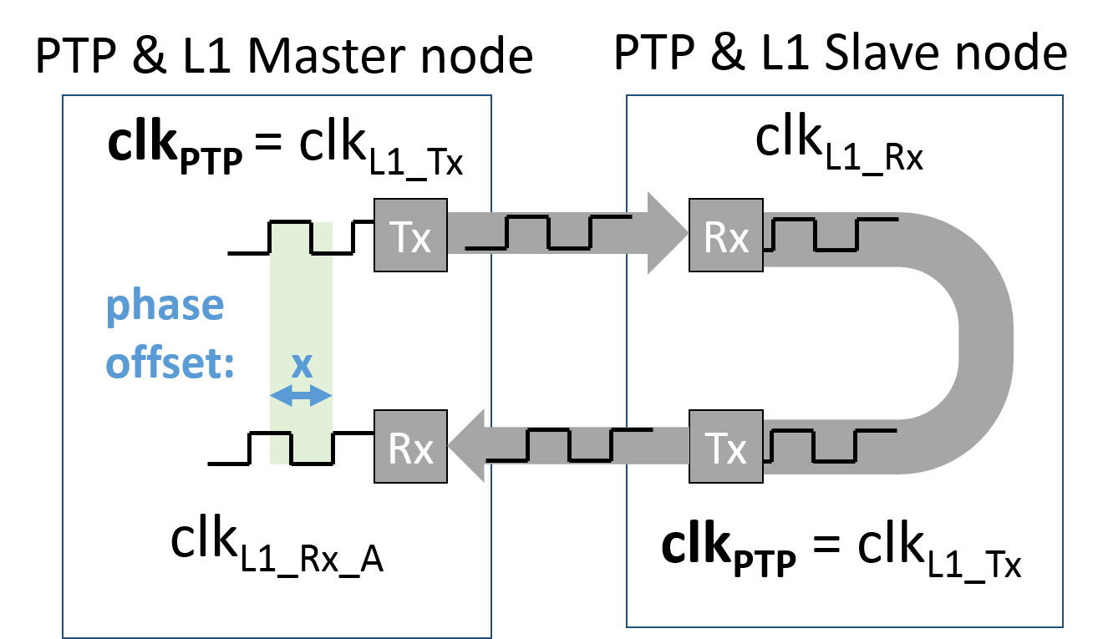
1. L1 syntonization in WR
Local PTP clock is the same as L1 clock

Slide 8
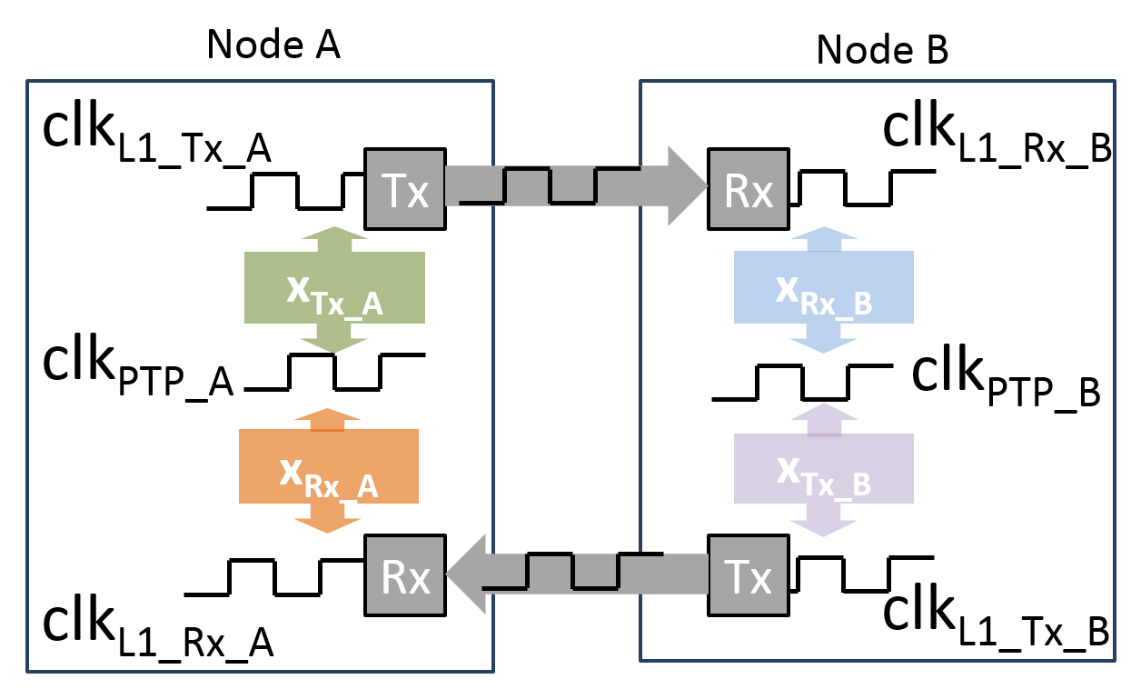
1. L1 syntonization in HA
Flexible and configurable relation between PTP and L1 clocks
All phase offsets known and pseudo-constant

Slide 9
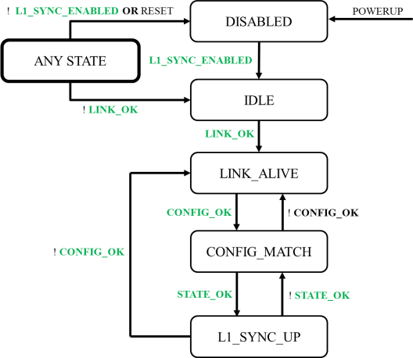
1. L1 syntonization in HA
Introduces a new L1 state machine
Semi-independent from PTP state machine
Detects if a peer port supports L1Sync
Handles L1 configuration matching

Slide 10
2. Correction of PTP calculations
Delay asymmetry estimation:
In WR: ${delay}_{ms}=\frac{1+α}{2+α} δ_{mm}$
In HA: ${delay}_{ms}= <delayAsymmetry> + <meanDelay>$
$$<delayAsymmetry> =constantAsymmetry+ \frac{α}{2+α}<meanDelay>$$

Slide 11
2. Correction of PTP calculations
Delay asymmetry estimation:
In WR: ${delay}_{ms}=\frac{1+α}{2+α} δ_{mm}$
In HA: ${delay}_{ms}= <delayAsymmetry> + <meanDelay>$
$$<delayAsymmetry> =constantAsymmetry+ \frac{α}{2+α}<meanDelay>$$
Hardware delays:
In WR: only Slave corrects ${offset}_{ms}$ for $∆_{TXM},∆_{RXM},∆_{TXS},∆_{RXS}$
In HA: both Master and Slave correct timestamps for ingress/egress latencies

Slide 12
3. WR Calibration procedure v1.1
In HA: “Calibration Procedures”
Rewritten into informative annex
Rewritten to use IEEE-1588 terminology and data sets
Exactly the same step-by-step procedure
Does not include
Mathematical proofs
Measurement errors estimation
Notes:
MasterOnly PTP ports – BMC running, but some ports disalowed from being Slave
External configuration – disable BMCA, use management to configure port state

Slide 13
4. Assignment of fixed roles
MasterOnly PTP Ports
Best Master Clock Algorithm running
Some ports disallowed from becoming PTP Slaves
Notes:
MasterOnly PTP ports – BMC running, but some ports disalowed from being Slave
External configuration – disable BMCA, use management to configure port state

Slide 14
4. Assignment of fixed roles
MasterOnly PTP Ports
Best Master Clock Algorithm running
Some ports disallowed from becoming PTP Slaves
Mechanism for external role configuration
Best Master Clock Algorithm disabled
External mechanism to configure PTP port state
Notes:
MasterOnly PTP ports – BMC running, but some ports disalowed from being Slave
External configuration – disable BMCA, use management to configure port state

Slide 15
5. WR PTP Profile
“High Accuracy Delay Request-Response Default PTP Profile”
Extends Delay Req-Resp Default PTP Profile
Mandates support of optional features required by High Accuracy
Defines default and allowed values for the optional features
Interoperates with Delay Req-Resp Default Profile
Defines High Accuracy Clock Model
Syntonization through Layer-1
Synchronization through PTP
Notes:
MasterOnly PTP ports – BMC running, but some ports disalowed from being Slave
External configuration – disable BMCA, use management to configure port state

Slide 16
Where is WR in IEEE1588-20XX?
L1 syntonization – Annex O
Correction of PTP calculations – Clause 16.7 / 16.8
Calibration procedure – Annex Q
Assignment of fixed roles – Clause 9.2.2.2 / 8.2.15.5.2 / 17.6
HA PTP Profile – Annex J.5
Sub-ns implementation – Annex P
Changes to core parts of the standard: https://www.ohwr.org/projects/wr-std/wiki/wrin1588

Slide 17
Where is WR in IEEE1588-20XX?
HA-specific optional features
Changes to the main clause of IEEE1588
Generic optional features
L1 Sync
Calculation of the delayAsymmetry
Mechanism for external configuration
master Only
mode
HA features require changes to 1588 clauses
Configurable correction of timestamps
HA Profile uses and requires support of
the HA and other optional features
High Accuracy Default PTP Profile
(Addition to Annex J)
Informative annex describes HA Profile
implementation that provides
sub-ns accuracy of synchronization
Sub-ns synchronization using High Accuracy Default Profile
(Annex P)

Slide 18
IEEE1588-20XX standardization process
2013 Jun: start
Project Authorization Request (PAR)

Slide 19
IEEE1588-20XX standardization process
2013 Jun: start
2016 Jan: stop new ideas
2016 Dec: PTP draft ready / 1st Ballot starts

Slide 20
IEEE1588-20XX standardization process
2013 Jun: start
2016 Jan: stop new ideas
2016 Dec: PTP draft ready / 1st Ballot starts
2017 Nov: 2nd Ballot starts
2018 Feb: 3rd Ballot starts

Slide 21
IEEE1588-20XX standardization process
2013 Jun: start
2016 Jan: stop new ideas
2016 Dec: PTP draft ready / 1st Ballot starts
2017 Nov: 2nd Ballot starts
2018 Feb: 3rd Ballot starts
2018 Aug: Sponsor Ballot

Slide 22
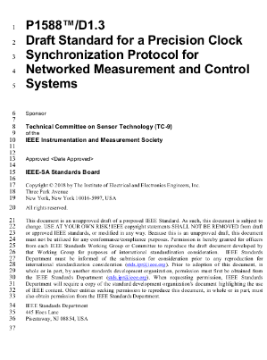
IEEE1588-20XX standardization process
2013 Jun: start
2016 Jan: stop new ideas
2016 Dec: PTP draft ready / 1st Ballot starts
2017 Nov: 2nd Ballot starts
2018 Feb: 3rd Ballot starts
2018 Aug: Sponsor Ballot
2019 Mid: Final draft ready

Slide 23
IEEE1588-20XX standardization process
2013 Jun: start
2016 Jan: stop new ideas
2016 Dec: PTP draft ready / 1st Ballot starts
2017 Nov: 2nd Ballot starts
2018 Feb: 3rd Ballot starts
2018 Aug: Sponsor Ballot
2019 Mid: Final draft ready
End-2019: Publication

Slide 24
IEEE1588-HA implementation
2013 Jun: start
2016 Jan: stop new ideas
2016 Sep: First implementation of L1 sync
2016 Dec: PTP draft ready /
1st Ballot starts
2017 Nov: 2nd Ballot starts
2018 Feb: 3rd Ballot starts
2018 Aug: Sponsor Ballot
2019 Mid: Final draft ready
End-2019: Publication

Slide 25
IEEE1588-HA implementation
2013 Jun: start
2016 Jan: stop new ideas
2016 Sep: Prototype implementation of L1 sync
2016 Dec: PTP draft ready /
1st Ballot starts
2017 Nov: 2nd Ballot starts
2018 Feb: 3rd Ballot starts
2018 Aug: Sponsor Ballot
now:
Automated compliance tests by Veryx
Ongoing work on HA implementation
HA demonstrated on ISPCS2018
2019 Mid: Final draft ready
End-2019: Publication

Slide 26
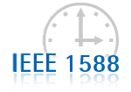
Summary
White Rabbit becomes High Accuracy profile of IEEE1588-20XX
New release of standard in final stage of preparation
Now going through the first Sponsor Balloting phase
We’re working on first HA implementation
Compliance tests developed independently
New IEEE-1588 standard to be published (hopefully) in 2019

