Slide 1
PPSi status and plans
Maciej Lipinski, Jean-Claude Bau, Adam Wujek

Slide 2
PPSi – PTP Ported to Silicon
Essential part of White Rabbit
Software implementing the WR-PTP
Portable for a wide range of architecture:
WR switch (ARM processor, Linux)
WR node (LM32, no OS)
x86 Linux
Enables protocol extension
More info: https://www.ohwr.org/attachments/3588/ISPCS2014_PPSi.pdf

Slide 3
PPSi since last WRS release (5.0.1)
In WRS release 5.0.1
PPSi works OK for WR
Its interoperability with PTP is far from perfect
Fixed known PTP compatibility problems
Invested a lot in tests
Acquired professional PTP test suite based on ATTEST framework by Veryx
Integrated the PTP test suite with WRS command line interface to automated enable regression tests
Developed ATTEST-based WR-PTP test suite – revealed mismatch between WR Spec and WR implementation
Added new features (of course)
Jean-Claude on board !

Slide 4
PPSi in upcoming WRS release (this year)
New features:
Fault injection (drop frames, add delay-rx, in timestamps)
Asserts
Faster phase re-track (from 5.9 to 1.4 seconds)
Abscal for absolute calibration
Leap second handling
Fixes
BMCA and foreign master qualification
Conformance to WR Spec (CALIBRATE message length, retries in WR FSM)
Conformance to PTP (message fields)
Re-organization
Parts of wrs_dump_shmem related to PPSi moved to its repo
NOTE: We need to update WR Spec to ensure coherence with WR implementation

Slide 5
PPSi release of WRS with HA and WR-PTP (next year?)
WR-PTP = White Rabbit Profile defined in WR Spec
HA = High Accuracy Default PTP Profile in IEEE1588-20XX
The only difference between HA and WR-PTP is in software
This year, in parallel:
Jean-Claude works on HA implementation
Veryx develops ATTEST-based High Accuracy Profile test suite
Goal:
Implementation of HA according to IEEE1588-20XX
Support of WR-PTP and HA on each port of WR Switch (support of HA only on a WR Node)
Full backward compatibility with WR-PTP
Support of configuration of all configurable parameters

Slide 6
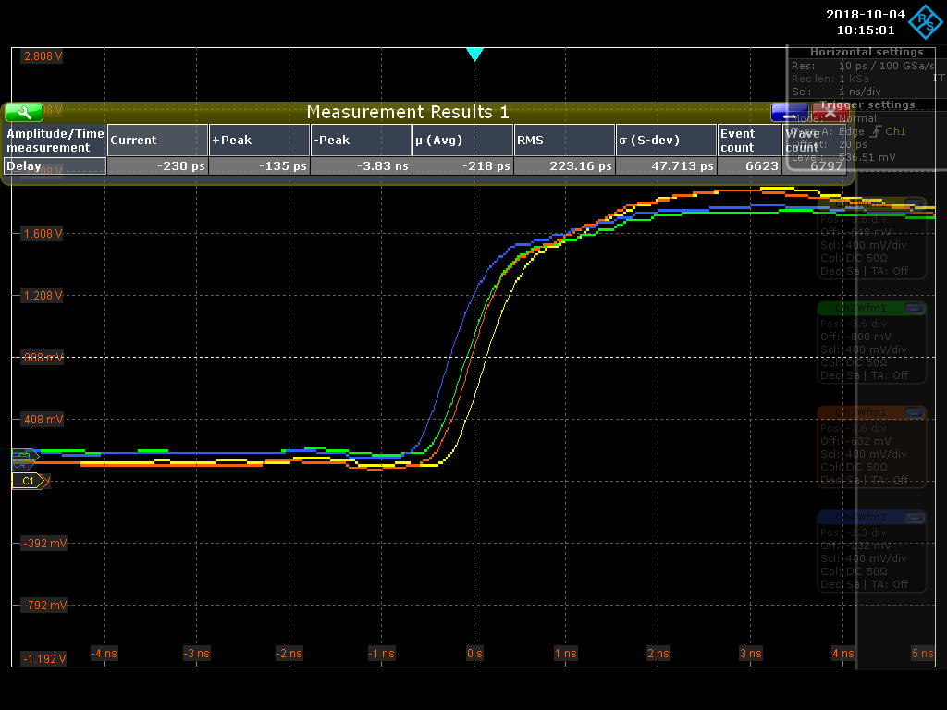
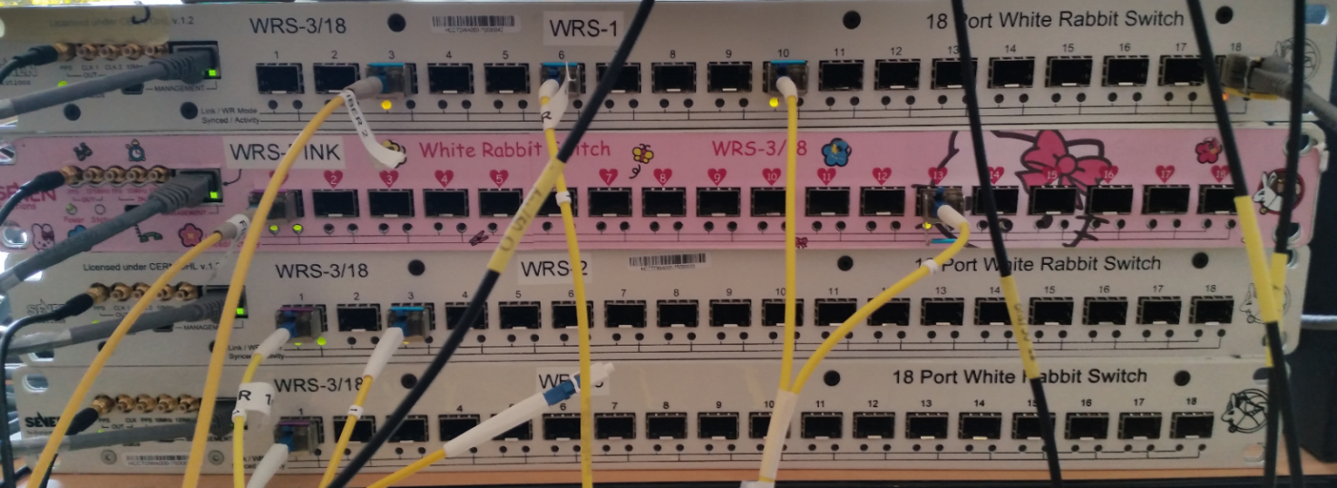
Mixed WR-PTP/HA network on ISPCS2018
Layout
WRS1
PPS
WR-PTP
10km
WR2
WRS1
HA
WRS3
WRS2
WRS3
WR-PTP
WRS4
WRS4

Slide 7
WR to HA migration
New nodes will implement only HA
Already deployed nodes will be updated to HA when/if possible
WR switches must support HA and WR-PTP – “autonegotiation”
Current situation:
WR Switch (WR-PTP)
WR-PTP
WR-PTP
PTP
WR Switch (WR-PTP)
Node
(WR-PTP)
Node
(PTP)
WR-PTP
PTP
Node
(WR-PTP)
Node
(PTP)

Slide 8
WR to HA migration
New nodes will implement only HA
Already deployed nodes will be updated to HA when/if possible
WR switches must support HA and WR-PTP – “autonegotiation”
We want to achieve:
WR Switch (WR)
WR-PTP
WR-PTP
PTP
WR Switch (WR-PTP +HA)
Node
(WR-PTP)
Node
(PTP)
WR-PTP
PTP
HA
HA
Node
(HA)
Node
(WR-PTP)
Node
(PTP)
WR Switch (WR-PTP +HA)

Slide 9
Veryx ATTEST tests on XENA
XENA – L2 switch network tester
ATTEST – framework for protocol test suites by Veryx
Our tests:
PTP-BC – 73 existing tests provided by Veryx (ready)
WR-PTP – 47 open source tests developed by Veryx (ready)
HA – 83 open source tests developed by Veryx (ongoing), will be available to anyone who buys ATTEST framework

Slide 10
Roadmap for PPSi
Release N (this year)
Compliance with PTP
Coherence between WR-PTP implementation and WR Spec (update needed)
Veryx/ATTEST regression tests for PTP and WR-PTP
Release N+1 (next year?)
Support for both WR-PTP and HA for WRS
Support for HA for WR node
PPSi independent from wrsw_hal
Support configuration of all configurable parameters (data sets)
Veryx/ATTEST regression tests for HA
Update of PPSi configuration file format (JSON)
Release N+2
Runtime reconfiguration of PPSi (currently restart needed)
Needed to be fully compliant with the standard
Allows easy compensation of temperature effects
Implementation of (to be official) PTP MIBs

