Slide 1

The New High Accuracy
Default PTP Profile in the IEEE 1588 Draft Revision
Maciej Lipiński
European Organization for Nuclear Research

Slide 2

Agenda
Overview
High Accuracy Default PTP Profile
  Optional features
  Inter-operation with other Default PTP Profiles
  Model of Local PTP Clock
Summary
2

Slide 3
Agenda
Overview
High Accuracy Default PTP Profile
  Optional features
  Inter-operation with other Default PTP Profiles
  Model of Local PTP Clock
Summary
2

Slide 4

White Rabbit
Update of CERN’s control and timing system
Sub-ns accuracy & sub-10ps precision
Based on IEEE 802.3, 802.1Q and 1588 (PTP) with extensions:
  L1 synchronization, similar to SyncE
  Precise phase detection
  Calibration and online estimation of asymmetries
  Extension of the PTP protocol to accommodate the above
De-facto standard for timing & daq in scientific applications
Implementation
3

Slide 5

















IEEE1588 standard revision
2013: start of IEEE1588 revision
Project Authorisation request:
“…support for synchronization to better than 1 nanosecond”
5 sub-committees
High Accuracy sub-committee
  Focus on White Rabbit
  Experts from industry and academia
  Division of WR into self-contained parts
  Definition of Optional Features and PTP Profile that
  allow WR-like implementation and WR performance
4

Slide 6
Agenda
Some history
High Accuracy Default PTP Profile
  Optional features
  Inter-operation with other Default PTP Profiles
  Model of Local PTP Clock
Summary

Slide 7
High Accuracy Default PTP Profile
High Accuracy Delay Request-Response Default PTP Profile
5

Slide 8
High Accuracy Default PTP Profile
High Accuracy Delay Request-Response Default PTP Profile
5

Slide 9
High Accuracy Default PTP Profile
High Accuracy Delay Request-Response Default PTP Profile
Identification: 00-1B-19-01-01-00
PTP Attributes: default values & ranges
Optional features /mechanism
  BMCA: default
  Mechanism: request-response by default, peer-to-peer allowed
  Required options: none
  Prohibited options: none
  Permitted options: all*
Clock physical requirements: frequency accuracy below 0.01%
* Optional feature inactive (disabled) by default
5

Slide 10
High Accuracy Default PTP Profile
High Accuracy Delay Request-Response Default PTP Profile
Identification: 00-1B-19-02-01-00
PTP Attributes: default values & ranges
Optional features /mechanism
  BMCA: default
  Mechanism: request-response by default, peer-to-peer allowed
  Required options: Annex O, Q.3, 16.7, 16.8, 17.6*, masterOnly*
  Prohibited options: 16.5
  Permitted options: all others*
Clock physical requirements: frequency accuracy below 4.6ppm
Default values & ranges for attributes of required options
High Accuracy model of Local PTP Clock
Information on inter-operation with other Default PTP Profiles
* Optional feature inactive (disabled) by default
5

Slide 11
Agenda
Some history
High Accuracy Default PTP Profile
  Optional features
  Inter-operation with other Default PTP Profiles
  Model of Local PTP Clock
Summary

Slide 12
Options required/prohibited by HA Profile
  Required and active by default:
  L1-based sync. performance enhancements [Annex O]
  Configurable correction of timestamps [16.7]
  Calculation of the <delayAsymmetry> for certain media [16.8]
  Requirements of Q.3 [Annex Q]
  Required and inactive by default:
  Mechanism for external config. of a PTP Instance’s PTP Port state [17.6]
  masterOnly mode [9.2.2.2 & 8.2.15.5.2]
  Prohibited:
  Isolation of PTP Instances [16.5]
6

Slide 13
Options required/prohibited by HA Profile
  Required and active by default:
  L1-based sync. performance enhancements [Annex O]
  Configurable correction of timestamps [16.7]
  Calculation of the <delayAsymmetry> for certain media [16.8]
  Requirements of Q.3 [Annex Q]
  Required and inactive by default:
  Mechanism for external config. of a PTP Instance’s PTP Port state [17.6]
  masterOnly mode [9.2.2.2 & 8.2.15.5.2]
  Prohibited:
  Isolation of PTP Instances [16.5]
6

Slide 14
L1 synchronization enhancements (L1Sync)
  Supports cooperation & defines relationship between
    PTP-based synchronization and
    L1-based syntonization, e.g. Synchronous Ethernet
  Provides configuration and status of the PTP-L1 relationship
  IMPORTANT: Requires hardware support
7

Slide 15
PTP synchronization and L1 syntonization
PTP Port/Instance A
PTP Port/Instance B
L1 syntonization
clk_{L1x_A}=clk_{L1x_B}
.
PTP synchronization
clk_{LocalPTP_A}=clk_{LocalPTP_B}
Local PTP
Local PTP
Clock
Clock
L1 syntonization
clk_{L1x_A}=clk_{L1x_B}
8

Slide 16
PTP synchronization and L1 syntonization
PTP Port/Instance A
PTP Port/Instance B
L1 Syntonization
clk_{L1x_A}=clk_{L1x_B}
PTP synchronization
clk_{LocalPTP_A}=clk_{LocalPTP_B}
Local PTP
Local PTP
Clock
Clock
L1 Syntonization
clk_{L1x_A}=clk_{L1x_B}
  Transmit coherent port: x_{tx} = constant, so clk_{L1tx}= clk_{LocalPTP}
  Receive coherent port : x_{rx} = constant, so clk_{L1rx}= clk_{LocalPTP}
  Congruent port : flow of L1 syntonization and PTP synchronization are the same
8

Slide 17
PTP synchronization and L1 syntonization
PTP Port/Instance A
PTP Port/Instance B
L1 Syntonization
clk_{L1x_A}=clk_{L1x_B}
PTP synchronization
clk_{LocalPTP_A}=clk_{LocalPTP_B}
Local PTP
Local PTP
Clock
Clock
L1 Syntonization
clk_{L1x_A}=clk_{L1x_B}
  Transmit coherent port: x_{tx} = constant, so clk_{L1tx}= clk_{LocalPTP}
  Receive coherent port : x_{rx} = constant, so clk_{L1rx}= clk_{LocalPTP}
  Congruent port : flow of L1 syntonization and PTP synchronization are the same
8

Slide 18
PTP synchronization and L1 syntonization
PTP Port/Instance A
PTP Port/Instance B
L1 Syntonization
clk_{L1x_A}=clk_{L1x_B}
PTP synchronization
clk_{LocalPTP_A}=clk_{LocalPTP_B}
Local PTP
Local PTP
Clock
Clock
L1 Syntonization
clk_{L1x_A}=clk_{L1x_B}
  Transmit coherent port: x_{tx} = constant, so clk_{L1tx}= clk_{LocalPTP}
  Receive coherent port : x_{rx} = constant, so clk_{L1rx}= clk_{LocalPTP}
  Congruent port : flow of L1 syntonization and PTP synchronization are the same
8

Slide 19
PTP synchronization and L1 syntonization
PTP Port/Instance A
PTP Port/Instance B
L1 Syntonization
clk_{L1x_A}=clk_{L1x_B}
PTP synchronization
clk_{LocalPTP_A}=clk_{LocalPTP_B}
Local PTP
Local PTP
Clock
Clock
L1 Syntonization
clk_{L1x_A}=clk_{L1x_B}
  Transmit coherent port: x_{tx} = constant, so clk_{L1tx}= clk_{LocalPTP}
  Receive coherent port : x_{rx} = constant, so clk_{L1rx}= clk_{LocalPTP}
  Congruent port : flow of L1 syntonization and PTP synchronization are the same
8

Slide 20
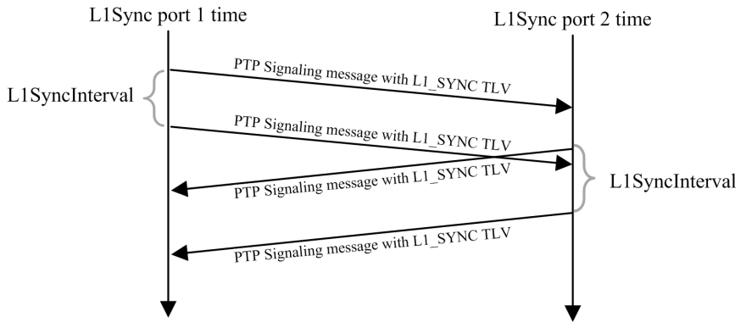
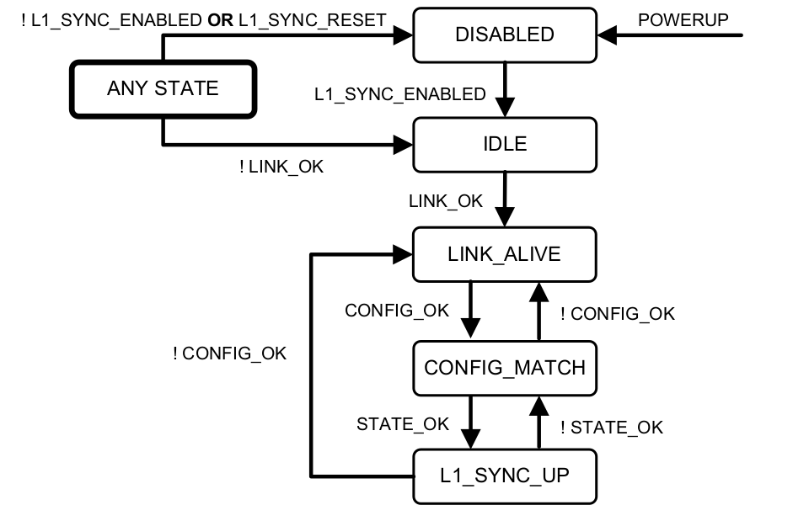
L1 synchronization enhancements (L1Sync)
  Data sets: storing config & status of the
  L1-PTP relationship (congruent, coherent)
  L1_SYNC TLVs:
    Detection of L1Sync-supporting PTP Ports
    Exchange of config/status/parameters
  FSM: control of establishing of the required PTP-L1 relationship
  Know PTP-L1 relationship: allows correction of timestamp with phase measurement
9

Slide 21
L1Sync in High Accuracy Default PTP Profile
  Requirement for L1Sync PTP Port to be: - transmit and receive coherent
  - congruent
PTP Port/Instance A
PTP Port/Instance B
Local PTP
Local PTP
Clock
Clock
x_{tx_A} = x_{rx_B} = x_{tx_B} = known constant
x_{rx_A} = phase measured to enhance timestamp precision
10

Slide 22
Options required/prohibited by HA Profile
  Required and active by default:
  L1-based sync. performance enhancements [Annex O]
  Configurable correction of timestamps [16.7]
  Calculation of the <delayAsymmetry> for certain media [16.8]
  Requirements of Q.3 [Annex Q]
  Required and inactive by default:
  Mechanism for external config. of a PTP Instance’s PTP Port state [17.6]
  masterOnly mode [9.2.2.2 & 8.2.15.5.2]
  Prohibited:
  Isolation of PTP Instances [16.5]

Slide 23
Configurable correction of timestamps
  IEEE1588-2019 (and 2008) defines timestamping ref. plane and allows correction of timestamps for <ingressLatency> and <egressLatency>:
  <ingressTimestamp>=<ingressProvidedTimestamp> – <ingressLatency>
  <egressTimestamp> = <egressProvidedTimestamp> + <egressLatency>
<ingressLatency>
PTP
code
PTP message
<egressLatency>
Medium
PTP device
Ref.
plane
11

Slide 24
Configurable correction of timestamps
  IEEE1588-2019 (and 2008) defines timestamping ref. plane and allows correction of timestamps for <ingressLatency> and <egressLatency>:
  <ingressTimestamp>=<ingressProvidedTimestamp> – <ingressLatency>
  <egressTimestamp> = <egressProvidedTimestamp> + <egressLatency>
  This optional feature:
    Defines timestampCorrectionPortDS
    dataset to store the values of
    <egressLatency> & <egressLatency>
    Mandates correction of timestamps
    with the provided values
11

Slide 25
Options required/prohibited by HA Profile
  Required and active by default:
  L1-based sync. performance enhancements [Annex O]
  Configurable correction of timestamps [16.7]
  Calculation of the <delayAsymmetry> for certain media [16.8]
  Requirements of Q.3 [Annex Q]
  Required and inactive by default:
  Mechanism for external config. of a PTP Instance’s PTP Port state [17.6]
  masterOnly mode [9.2.2.2 & 8.2.15.5.2]
  Prohibited:
  Isolation of PTP Instances [16.5]

Slide 26
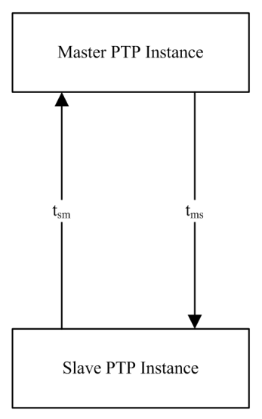
Calculation of <delayAsymmetry>
  IEEE1588-2019 (and 2008) provides calculation of <meanDelay>
  and allows correction of <meanDelay> for <delayAsymmetry>:
  <meanDelay> = [(t₂ – t₁ ) + (t₄ – t₃ )] / 2
  t_{ms} = <meanDelay> + <delayAsymmetry>
  t_{sm} = <meanDelay> – <delayAsymmetry>
  This optional feature:
    Defines <delayCoefficient> (α) to characterize asymmetry
    of applicable bidirectional media (e.g. bidirectional fiber)
    Specifies <delayAsymmetry> calculation using <delayCoefficient> (α)
    <delayAsymmetry> = constantAsymmetry + [α/(α+2)]·(<meanDelay>)
    Defines asymmetryCorrectionPortDS dataset for <delayCoefficient> & constantAsymmetry
    Mandates correction of <meanDelay> with the calcualted <delayAsymmetry>
12

Slide 27
Options required/prohibited by HA Profile
  Required and active by default:
  L1-based sync. performance enhancements [Annex O]
  Configurable correction of timestamps [16.7]
  Calculation of the <delayAsymmetry> for certain media [16.8]
  Requirements of Q.3 [Annex Q]
  Required and inactive by default:
  Mechanism for external config. of a PTP Instance’s PTP Port state [17.6]
  masterOnly mode [9.2.2.2 & 8.2.15.5.2]
  Prohibited:
  Isolation of PTP Instances [16.5]

Slide 28
Calibration
Values of <ingressLatency>, <egressLatency>, <delayCoefficient>
obtained using Calibration Procedures [Annex Q]
[Q.3] defines requirements for PTP Instance in calibration procedures:
  Output signal, e.g. pulse-per-second (PPS)
  Optional features in 16.7 & 16.8 supported and enabled
  The value <meanDelay> exposed to the user
  Timestamps with precision sufficient for the intended accuracy of synchronization
  <egressProvidedTimestamp> and <ingressProvidedTimestamp> corrected for
  semi-static latency (e.g. bitslide, see Q.2 and P.4.2)
  Timestamping Clock is the Local PTP Clock
13

Slide 29
Options required/prohibited by HA Profile
  Required and active by default:
  L1-based sync. performance enhancements [Annex O]
  Configurable correction of timestamps [16.7]
  Calculation of the <delayAsymmetry> for certain media [16.8]
  Requirements of Q.3 [Annex Q]
  Required and inactive by default:
  Mechanism for external config. of a PTP Instance’s PTP Port state [17.6]
  masterOnly mode [9.2.2.2 & 8.2.15.5.2]
  Prohibited:
  Isolation of PTP Instances [16.5]

Slide 30
External config. of PTP Port state & masterOnly
Best Master Clock Algorithm (BMCA) defines the state of each PTP Port
in BC/OC and synchronization hierarchy in the entire PTP Network
Mechanism for external config. of a PTP Instance’s PTP Port state:
  Disables BMCA and affects all PTP Ports on a PTP Instance
  Allows configuring the desired state of each PTP Port
  Defines externalPortConfigurationPortDS dataset to store the desired state
  Provides external configuration of synchronization hierarchy in the entire PTP network
masterOnly mode on PTP Port:
  Maintains operation of BMCA and provides configuration per PTP Port
  Results in PTP Port ignoring Announce messages and defaulting to Master state
  Prevents PTP Instance from “slaving” on particular PTP Ports (e.g. access ports)
14

Slide 31
Options required/prohibited by HA Profile
  Required and active by default:
  L1-based sync. performance enhancements [Annex O]
  Configurable correction of timestamps [16.7]
  Calculation of the <delayAsymmetry> for certain media [16.8]
  Requirements of Q.3 [Annex Q]
  Required and inactive by default:
  Mechanism for external config. of a PTP Instance’s PTP Port state [17.6]
  masterOnly mode [9.2.2.2 & 8.2.15.5.2]
  Prohibited:
  Isolation of PTP Instances [16.5]

Slide 32
Agenda
Some history
High Accuracy Default PTP Profile
  Optional features
  Inter-operation with other Default PTP Profiles
  Model of Local PTP Clock
Summary

Slide 33
Inter-operation with Default PTP Profiles
High Accuracy Delay Request-Response Default PTP Profile
  Inter-operation with Delay Request-Response Default PTP Profile
  Inter-operation with Peer-to-Peer Default PTP Profile, if peer-to-peer mechanism supported
  No inter-operation with Transparent Clocks
  No enhancements of synchronization performance
PTP Port in Master state:
PTP Port in Slave state:
Operation as if connected to a Request-Response Default PTP Profile
High Accuracy Default PTP profile
Request-Response
Default PTP Profile
Operation as if it was Request-Response Default PTP Profile
Request-Response
Default PTP Profile
High Accuracy Default PTP profile
15

Slide 34
Agenda
Some history
High Accuracy Default PTP Profile
  Optional features
  Inter-operation with other Default PTP Profiles
  Model of Local PTP Clock
Summary

Slide 35
High Accuracy model of Local PTP Clock
High Accuracy Local PTP Clock in J.5.5 – highlights:
Syntonization of Local PTP Clock
  Physical to the Grandmaster, e.g. L1 clock signal
  Independent from the PTP timing message exchange
Synchronization of Local PTP Clock using PTP timing messages
16

Slide 36
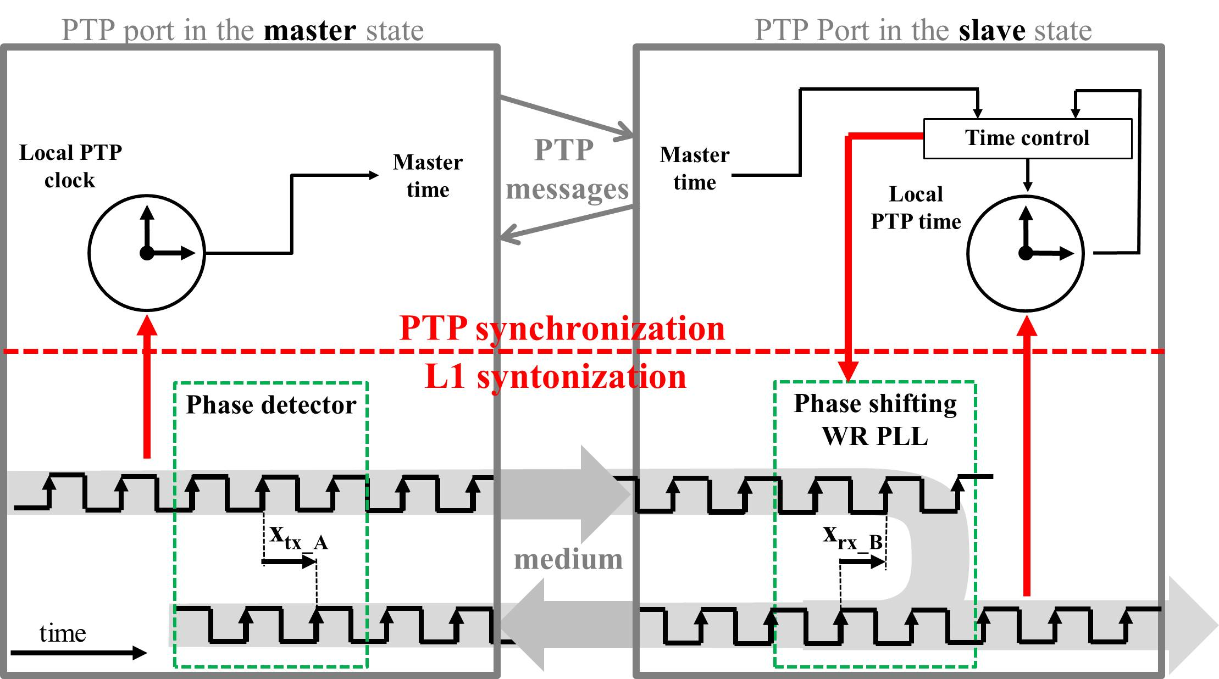
High Accuracy model of Local PTP Clock
16

Slide 37
Agenda
Some history
High Accuracy Default PTP Profile
  Optional features
  Inter-operation with other Default PTP Profiles
  Model of Local PTP Clock
Summary

Slide 38
Summary
IEEE1588
“Core”
Defines attributes
and mechanisms
High Accuracy Request-Response Default PTP Profile
(Annex J)
17

Slide 39
Summary
HA-specific optional features
(active by default)
IEEE1588
“Core”
Calculation of the delayAsymmetry
L1 Sync
Enhance
Configurable correction of timestamps
Requires and specifies
default/allowed values
Defines attributes
and mechanisms
High Accuracy Request-Response Default PTP Profile
(Annex J)
17

Slide 40
Summary
HA-specific optional features
(active by default)
IEEE1588
“Core”
Calculation of the delayAsymmetry
L1 Sync
Enhance
Calibration
(Annex Q)
Configurable correction of timestamps
Requires and specifies
default/allowed values
Defines attributes
and mechanisms
High Accuracy Request-Response Default PTP Profile
(Annex J)
17

Slide 41
Summary
HA-specific optional features
(active by default)
IEEE1588
“Core”
Generic optional features
(inactive by default)
Modify
BMCA
Calculation of the delayAsymmetry
L1 Sync
Enhance
Mechanism for external configuration
master Only
mode
Calibration
(Annex Q)
Configurable correction of timestamps
Requires and specifies
default/allowed values
Defines attributes
and mechanisms
Requires and specifies
default/allowed values
High Accuracy Request-Response Default PTP Profile
(Annex J)
17

Slide 42
Summary
HA-specific optional features
(active by default)
IEEE1588
“Core”
Generic optional features
(inactive by default)
Modify
BMCA
Calculation of the delayAsymmetry
L1 Sync
Enhance
Mechanism for external configuration
master Only
mode
Calibration
(Annex Q)
Configurable correction of timestamps
Requires and specifies
default/allowed values
Defines attributes
and mechanisms
Requires and specifies
default/allowed values
High Accuracy Request-Response Default PTP Profile
(Annex J)
Informative annex describes HA Profile
implementation that provides
sub-ns accuracy of synchronization
Sub-ns synchronization using High Accuracy Default Profile
(Annex P)
17

Slide 43

Summary
???
HA-specific optional features
(active by default)
IEEE1588
“Core”
Generic optional features
(inactive by default)
Modify
BMCA
Calculation of the delayAsymmetry
L1 Sync
Enhance
Mechanism for external configuration
master Only
mode
Calibration
(Annex Q)
Configurable correction of timestamps
Requires and specifies
default/allowed values
Defines attributes
and mechanisms
Requires and specifies
default/allowed values
High Accuracy Request-Response Default PTP Profile
(Annex J)
Informative annex describes HA Profile
implementation that provides
sub-ns accuracy of synchronization
Sub-ns synchronization using High Accuracy Default Profile
(Annex P)
17

Slide 44
Backup slides

Slide 45
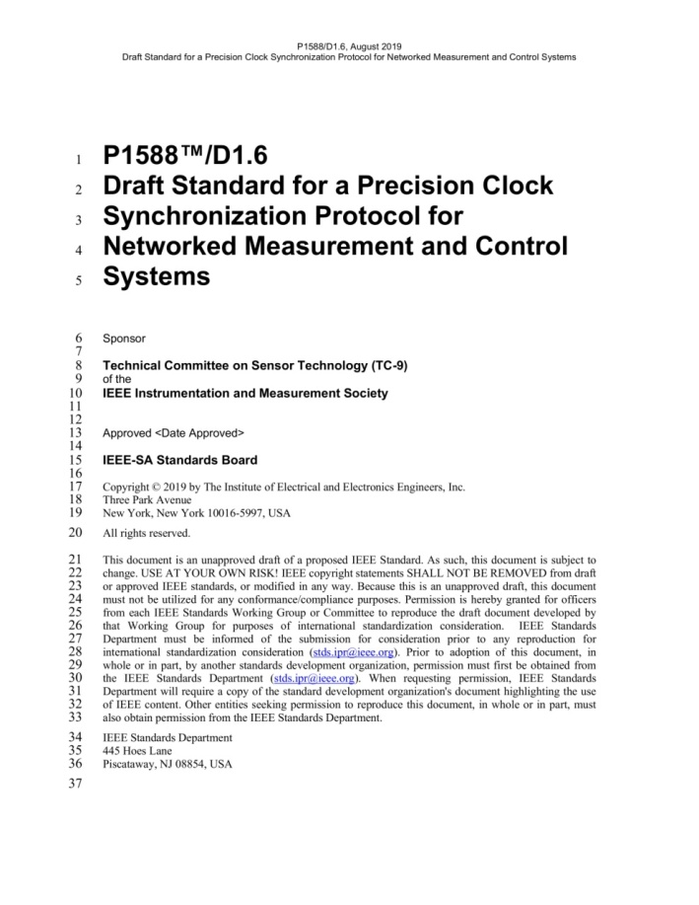
PTP Profiles and Optional Features
18

Slide 46
PTP Profiles and Optional Features
“Synchronization framework”
“Extensible &
parameterized
core”
(attributes,
delay mechanism)
Optional parts
(optional features)
18

Slide 47
PTP Profiles and Optional Features
“Synchronization framework”
“Extensible &
parameterized
core”
(attributes,
delay mechanism)
Transport mappings
Optional parts
(optional features)
Informative Annexes
18

Slide 48

PTP Profiles and Optional Features
“Synchronization framework”
“Extensible &
parameterized
core”
(attributes,
delay mechanism)
Telecom
PTP
Applications
Transport mappings
Optional parts
(optional features)
Informative Annexes
Power
18

Slide 49
PTP Profiles and Optional Features
“Synchronization framework”
“Extensible &
parameterized
core”
(attributes,
delay mechanism)
Telecom
PTP
Applications
Profile: delay mechanism, attribute values & options
Transport mappings
Optional parts
(optional features)
Informative Annexes
Power
18

Slide 50
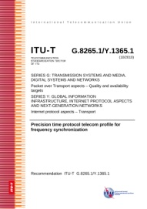

PTP Profiles and Optional Features
“Synchronization framework”
“Extensible &
parameterized
core”
(attributes,
delay mechanism)
Telecom
ITU-T Profiles
PTP
Applications
Profile: delay mechanism, attribute values & options
Transport mappings
Optional parts
(optional features)
Informative Annexes
IEEE/IEC Profiles
Power
18

Slide 51
PTP Profiles and Optional Features
“Synchronization framework”
Default Profiles
Delay Request-Response
Peer-to-peer
High Accuracy Delay Request-Response
“Extensible &
parameterized
core”
(attributes,
delay mechanism)
PTP
Applications
Profile: delay mechanism, attribute values & options
Transport mappings
Optional parts
(optional features)
Informative Annexes
18

