Slide 1
White Rabbit Applications
John Gill, Dimitris Lampridis, Maciej Lipinski
CERN BE-CO
Hardware and Timing Section
BE Seminar
22 November 2019

Slide 2
Outline
WR in a nutshell
BTrain over WR (Maciej)
WR Trigger Distribution (Dimitris)
RF Signal Distribution over WR (John)
Q&A
2

Slide 3
Outline
WR in a nutshell
BTrain over WR (Maciej)
WR Trigger Distribution (Dimitris)
RF Signal Distribution over WR (John)
Q&A
2

Slide 4
White Rabbit in a nutshell
CERN and GSI initiative for control & timing
3

Slide 5
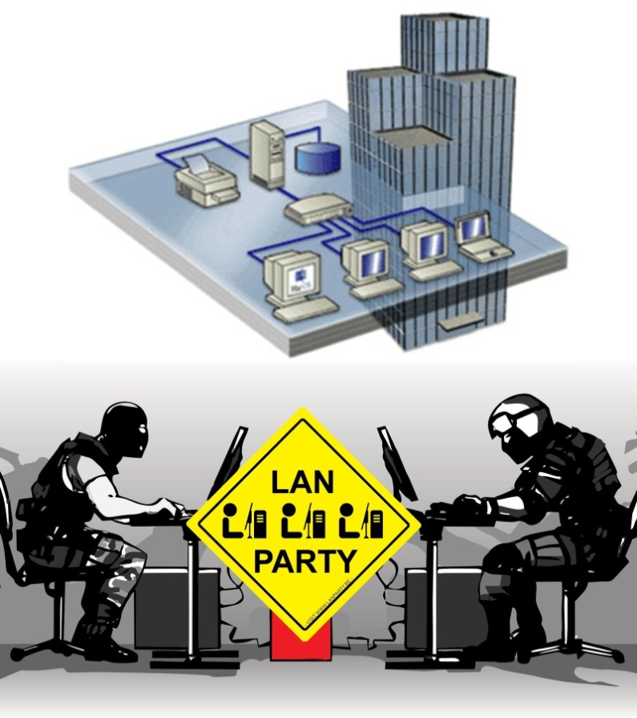
White Rabbit in a nutshell
CERN and GSI initiative for control & timing
Based on well-established standards
Ethernet (IEEE 802.3)
Bridged Local Area Network (IEEE 802.1Q)
3

Slide 6
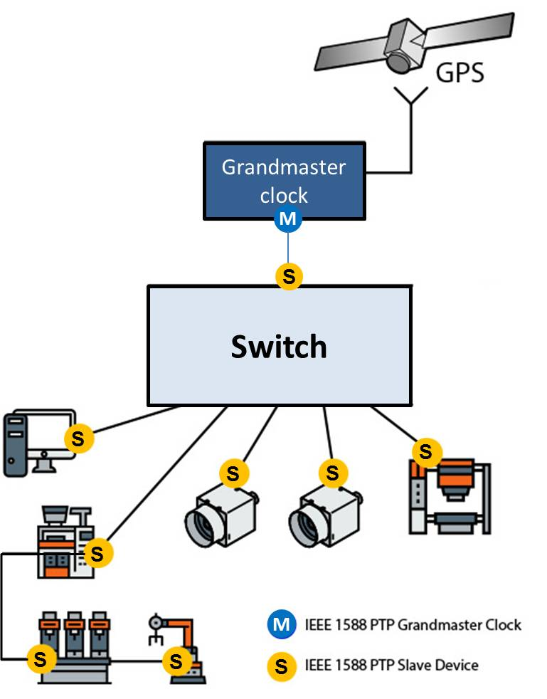
White Rabbit in a nutshell
CERN and GSI initiative for control & timing
Based on well-established standards
Ethernet (IEEE 802.3)
Bridged Local Area Network (IEEE 802.1Q)
Precision Time Protocol (IEEE 1588)
3

Slide 7
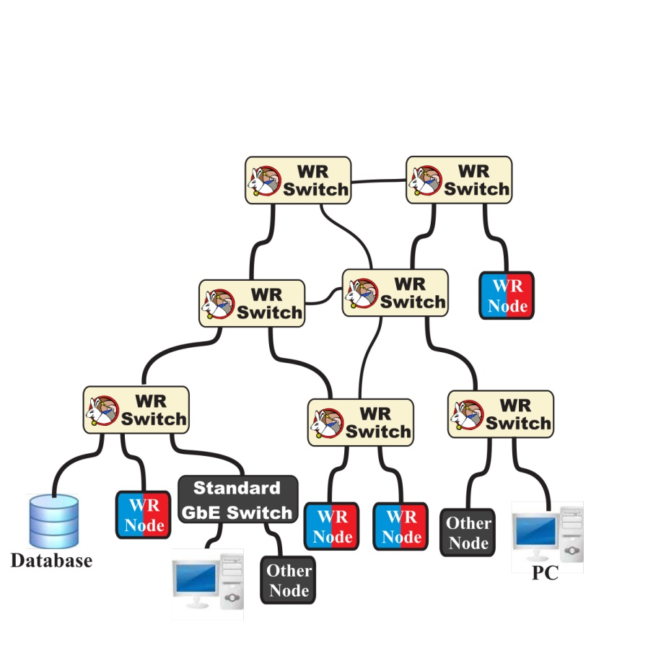
White Rabbit in a nutshell
CERN and GSI initiative for control & timing
Based on well-established standards
Ethernet (IEEE 802.3)
Bridged Local Area Network (IEEE 802.1Q)
Precision Time Protocol (IEEE 1588)
3

Slide 8
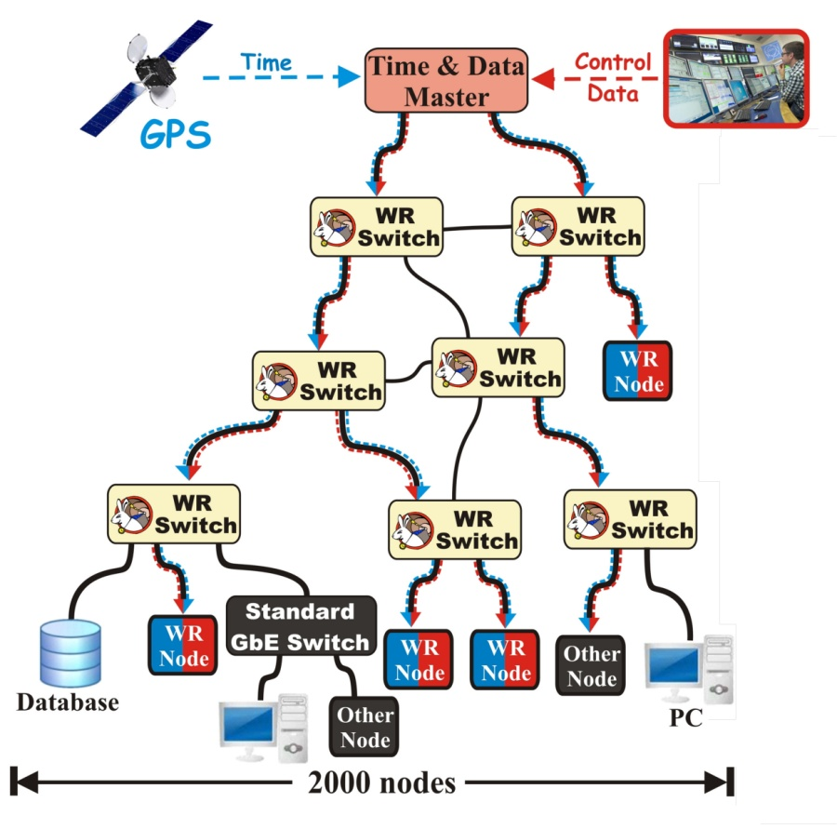
White Rabbit in a nutshell
CERN and GSI initiative for control & timing
Based on well-established standards
Ethernet (IEEE 802.3)
Bridged Local Area Network (IEEE 802.1Q)
Precision Time Protocol (IEEE 1588)
Extends standards to provide
Sub-ns synchronisation (included in IEEE 1588)
Deterministic data transfer
3

Slide 9
White Rabbit in a nutshell
CERN and GSI initiative for control & timing
Based on well-established standards
Ethernet (IEEE 802.3)
Bridged Local Area Network (IEEE 802.1Q)
Precision Time Protocol (IEEE 1588)
Extends standards to provide
Sub-ns synchronisation (included in IEEE 1588)
Deterministic data transfer
Initial specs: links ≤10 km & ≤2000 nodes
3

Slide 10
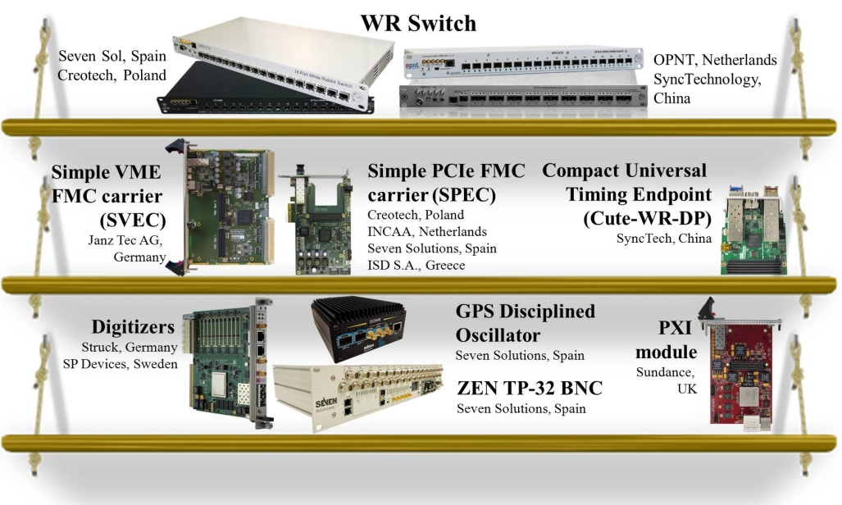
White Rabbit in a nutshell
CERN and GSI initiative for control & timing
Based on well-established standards
Ethernet (IEEE 802.3)
Bridged Local Area Network (IEEE 802.1Q)
Precision Time Protocol (IEEE 1588)
Extends standards to provide
Sub-ns synchronisation (included in IEEE 1588)
Deterministic data transfer
Initial specs: links ≤10 km & ≤2000 nodes
Open Source and commercially available
3

Slide 11
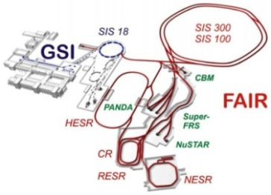
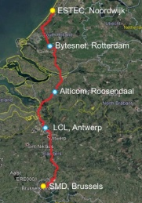
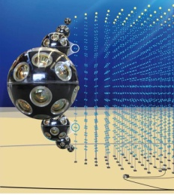
White Rabbit in a nutshell
CERN and GSI initiative for control & timing
Based on well-established standards
Ethernet (IEEE 802.3)
Bridged Local Area Network (IEEE 802.1Q)
Precision Time Protocol (IEEE 1588)
Extends standards to provide
Sub-ns synchronisation (included in IEEE 1588)
Deterministic data transfer
Initial specs: links ≤10 km & ≤2000 nodes
Open Source and commercially available
Many applications worldwide
CERN & GSI
Accelerator Facilities
German Stock Exchange
National Time Labs
(NL, FI, FR, US, UK, IT)
European Space Agency
for Galileo
Large High Altitude Air
Shower Observatory
Cubic Kilometre
Neutrino Telescope
Telecommunication for High Accuracy Time Dissemination
http://www.ohwr.org/projects/white-rabbit/wiki/WRUsers
3

Slide 12
White Rabbit in a nutshell
CERN and GSI initiative for control & timing
Based on well-established standards
Ethernet (IEEE 802.3)
Bridged Local Area Network (IEEE 802.1Q)
Precision Time Protocol (IEEE 1588)
Extends standards to provide
Sub-ns synchronisation (included in IEEE 1588)
Deterministic data transfer
Initial specs: links ≤10 km & ≤2000 nodes
Open Source and commercially available
Many applications worldwide
More in “Introduction to WR Technologies” https://indico.cern.ch/event/862562/
CERN & GSI
Accelerator Facilities
German Stock Exchange
National Time Labs
(NL, FI, FR, US, UK, IT)
European Space Agency
for Galileo
Large High Altitude Air
Shower Observatory
Cubic Kilometre
Neutrino Telescope
Telecommunication for High Accuracy Time Dissemination
http://www.ohwr.org/projects/white-rabbit/wiki/WRUsers
3

Slide 13
Outline
WR in a nutshell
BTrain over WR (Maciej)
WR Trigger Distribution (Dimitris)
RF Signal Distribution over WR (John)
Q&A

Slide 14
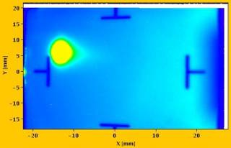
Synchrotron operation
Bending
magnet
B (t)
Coordination required between:
f (t) – RF in accelerating cavities
B(t) – magnetic field in bending magnets
I(t) – current provided by power converters
Beam Instrumentation diagnostics
I(t)
f_{rev} (t)
V
Beam Inst.
Diagnostics
Accelerating
RF cavity
Power
converter
4

Slide 15
Synchrotron operation
Bending
magnet
B (t)
Coordination required between:
f (t) – RF in accelerating cavities
B(t) – magnetic field in bending magnets
I(t) – current provided by power converters
Beam Instrumentation diagnostics
Coordination provided by
the BTrain system
I(t)
f_{rev} (t)
V
Beam Inst.
Diagnostics
Accelerating
RF cavity
Power
converter
4

Slide 16
BTrain System
Bending
magnet
B (t)
I(t)
f_{rev} (t)
V
Beam Inst.
Diagnostics
Accelerating
RF cavity
Power
converter
5

Slide 17
BTrain System
Bending
magnet
B (t)
I(t)
B
B
B
f_{rev} (t)
V
Beam Inst.
Diagnostics
Accelerating
RF cavity
Power
converter
5

Slide 18
BTrain System
Bending
magnet
B (t)
1us
0.1 Gauss =
(max 500kHz)
24V
I(t)
B
B
B
f_{rev} (t)
V
Beam Inst.
Diagnostics
Accelerating
RF cavity
Power
converter
5

Slide 19
BTrain System
Bending
magnet
B (t)
marker 2 (optional)
B_{flat top}
B(t)
coil measurement V_{coil} ~ Ḃ
I(t)
Peaking strip
marker 1
B
B
B
B_{flat bottom}
f_{rev} (t)
t₁
t₂
time
V
Beam Inst.
Diagnostics
Accelerating
RF cavity
Power
converter
5

Slide 20
BTrain System
Bending
magnet
B (t)
marker 2 (optional)
B_{flat top}
B(t)
coil measurement V_{coil} ~ Ḃ
I(t)
Peaking strip
marker 1
B
B
B
B_{flat bottom}
f_{rev} (t)
t₁
t₂
time
preset B(t₁)
+0.1G
B(t)
V
- 0.1G
Beam Inst.
Diagnostics
Accelerating
RF cavity
Power
converter
5

Slide 21
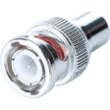
BTrain System
Bending
magnet
B (t)
marker 2 (optional)
B_{flat top}
B(t)
coil measurement V_{coil} ~ Ḃ
I(t)
Peaking strip
marker 1
B
B
B
B_{flat bottom}
f_{rev} (t)
t₁
t₂
time
preset B(t₁)
+0.1G
B(t)
V
- 0.1G
~ V_{coil}
Beam Inst.
Diagnostics
Accelerating
RF cavity
Power
converter
5

Slide 22
FIRESTORM to renovate BTrain
Bending
magnet
B (t)
Project by Magnets, Superconductors & Cryostats (TE-MSC) Group in collaboration with TE-EPC, BE-RF, BE-BI & BE-CO.
Why to renovate:
Higher resolution (0.05G) required in PS
Peak slope of 6T/s required by PSB
Spikes & noise on Bdot, timing problems with marker
Obsolete measurement technology and aging components
Non-standard equipment, little support from CO
Not uniform across accelerators & limited diagnostics
What to renovate:
Measurement technology – new markers and coils
Data transfer technology – White Rabbit
I(t)
B
B
B
f_{rev} (t)
V
Beam Inst.
Diagnostics
Accelerating
RF cavity
Power
converter
6

Slide 23
FIRESTORM to renovate BTrain
Bending
magnet
B (t)
Project by Magnets, Superconductors & Cryostats (TE-MSC) Group in collaboration with TE-EPC, BE-RF, BE-BI & BE-CO.
Why to renovate:
Higher resolution (0.05G) required in PS
Peak slope of 6T/s required by PSB
Spikes & noise on Bdot, timing problems with marker
Obsolete measurement technology and aging components
Non-standard equipment, little support from CO
Not uniform across accelerators & limited diagnostics
What to renovate:
Measurement technology – new markers and coils
Data transfer technology – White Rabbit
WR Node
I(t)
WR Switch
f_{rev} (t)
V
Beam Inst.
Diagnostics
Accelerating
RF cavity
Power
converter
6

Slide 24
BTrain data transfer over WR
Bending
magnet
B (t)
I(t)
WR Switch
f_{rev} (t)
V
Beam Inst.
Diagnostics
Accelerating
RF cavity
Power
converter
7

Slide 25
BTrain data transfer over WR
Bending
magnet
B (t)
Digitally distributes absolute values of B and Bdot in Ethernet frames
Distributes simultaneously B from different sources (old B, measured B, simulated B, synthesized B)
Provides additional control information (C0, marker)
Supports resolution down to 0.0001G
Allows rates >500kHz and infinitely fast ramps
Deterministic & guarantees max latency of 10us
Provides extensive diagnostics
Provides flexibility and scalability
I(t) is sent back for model analysis
Payload of Ethernet Frame
CTRL | B | Bdot | oldB | meaB | simB | synB
CTRL
I
I(t)
WR Switch
f_{rev} (t)
V
Beam Inst.
Diagnostics
Accelerating
RF cavity
Power
converter
7

Slide 26
BTrain data transfer over WR
Bending
magnet
B (t)
Digitally distributes absolute values of B and Bdot in Ethernet frames
Distributes simultaneously B from different sources (old B, measured B, simulated B, synthesized B)
Provides additional control information (C0, marker)
Supports resolution down to 0.0001G
Allows rates >500kHz and infinitely fast ramps
Deterministic & guarantees max latency of 10us
Provides extensive diagnostics
Provides flexibility and scalability
I(t) is sent back for model analysis
I(t) exchanged internally for Pole Face Winding (PFW) of Power Converters
Payload of Ethernet Frame
CTRL | B | Bdot | oldB | meaB | simB | synB
CTRL
I
I(t)
WR Switch
f_{rev} (t)
V
Beam Inst.
Diagnostics
Accelerating
RF cavity
Power
converter
7

Slide 27
BTrain data transfer over WR
Bending
magnet
B (t)
Digitally distributes absolute values of B and Bdot in Ethernet frames
Distributes simultaneously B from different sources (old B, measured B, simulated B, synthesized B)
Provides additional control information (C0, marker)
Supports resolution down to 0.0001G
Allows rates >500kHz and infinitely fast ramps
Deterministic & guarantees max latency of 10us
Provides extensive diagnostics
Provides flexibility and scalability
I(t) is sent back for model analysis
I(t) exchanged internally for Pole Face Winding (PFW) of Power Converters
Payload of Ethernet Frame
CTRL | B | Bdot | oldB | meaB | simB | synB
CTRL
I
I(t)
WR Switch
f_{rev} (t)
SPS RF
V
NOTE: Accelerating RF cavities to be
controlled in SPS using WR
Beam Inst.
Diagnostics
Accelerating
RF cavity
Power
converter
7

Slide 28
WR-BTrain Nodes
Bending
magnet
B (t)
I(t)
WR Switch
f_{rev} (t)
V
Beam Inst.
Diagnostics
Accelerating
RF cavity
Power
converter
8

Slide 29
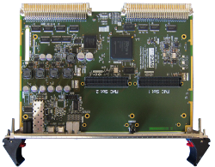
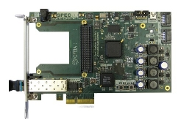
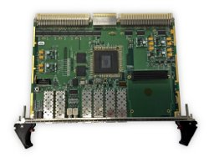
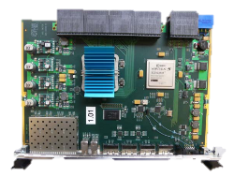
WR-BTrain Nodes
Bending
magnet
B (t)
Simple VME64x FMC Carrier (SVEC)
Simple PCIe FMC carrier (SPEC)
VME FMC Carrier HPC-DDR3 (VFC-HD)
VXS Switch
FPGA
I(t)
FPGA
WR Switch
FPGA
f_{rev} (t)
V
FPGA
Beam Inst.
Diagnostics
Accelerating
RF cavity
Power
converter
8

Slide 30
WR-BTrain Nodes
Bending
magnet
B (t)
Simple VME64x FMC Carrier (SVEC)
Simple PCIe FMC carrier (SPEC)
VME FMC Carrier HPC-DDR3 (VFC-HD)
VXS Switch
FPGA
CO-supported
hardware
I(t)
FPGA
WR Switch
FPGA
f_{rev} (t)
V
FPGA
Beam Inst.
Diagnostics
Accelerating
RF cavity
Power
converter
8

Slide 31
WR-BTrain Nodes
Bending
magnet
B (t)
CO-support
for
White Rabbit
Simple VME64x FMC Carrier (SVEC)
Simple PCIe FMC carrier (SPEC)
VME FMC Carrier HPC-DDR3 (VFC-HD)
VXS Switch
FPGA
I(t)
FPGA
WR Switch
FPGA
f_{rev} (t)
V
FPGA
Beam Inst.
Diagnostics
Accelerating
RF cavity
Power
converter
8

Slide 32
BTrain over White Rabbit Project
FPGA
User logic
B
I
https://gitlab.cern.ch/BTrain-TEAM/Btrain-over-WhiteRabbit/wikis/home
BTrain over
White Rabbit
Simple VME64x FMC Carrier (SVEC)
Simple PCIe FMC carrier (SPEC)
VME FMC Carrier HPC-DDR3 (VFC-HD)
VXS Switch
FPGA
FPGA
WR Switch
FPGA
FPGA
FPGA
BTrain over
White Rabbit
BTrain over
White Rabbit
BTrain over
White Rabbit
FPGA
B
I
B
I
B
I
User logic
User logic
User logic
FPGA
9

Slide 33
BTrain over White Rabbit Project
FPGA
User logic
B
I
https://gitlab.cern.ch/BTrain-TEAM/Btrain-over-WhiteRabbit/wikis/home
BTrain over
White Rabbit
WR Switch
FPGA
FPGA
FPGA
BTrain over
White Rabbit
BTrain over
White Rabbit
BTrain over
White Rabbit
B
I
B
I
B
I
User logic
User logic
User logic
9

Slide 34
BTrain over White Rabbit Project
FPGA
User logic
B
I
https://gitlab.cern.ch/BTrain-TEAM/Btrain-over-WhiteRabbit/wikis/home
WR PTP Core
WR time and Ethernet Frames
Diagnostics over WR network
WR Streamers
Data Transfer Layer: FIFO over White Rabbit
Statistics of network latency and lost frames
Option to fix latency at configurable value
BTrainFrameTransceiver
API to the user logic (VHDL records)
Encoding/decoding of BTrain Frames (format agreed by all BTrain users)
Transmission/reception of BTrain frames using WR Streamers
BTrainFrameTxRx
WR Streamers
WR PTP Core
WR Switch
FPGA
FPGA
FPGA
WR PTP Core
WR PTP Core
WR PTP Core
WR Streamers
WR Streamers
WR Streamers
BTrainFrameTxRx
BTrainFrameTxRx
BTrainFrameTxRx
B
I
B
I
B
I
User logic
User logic
User logic
9

Slide 35
BTrain over White Rabbit Project
FPGA
User logic
B
I
https://gitlab.cern.ch/BTrain-TEAM/Btrain-over-WhiteRabbit/wikis/home
WR PTP Core
WR time and Ethernet Frames
Diagnostics over WR network
WR Streamers
Data Transfer Layer: FIFO over White Rabbit
Statistics of network latency and lost frames
Option to fix latency at configurable value
BTrainFrameTransceiver
API to the user logic (VHDL records)
Encoding/decoding of BTrain Frames (format agreed by all BTrain users)
Transmission/reception of BTrain frames using WR Streamers
BTrainFrameTxRx
WR Streamers
WR PTP Core
WR Switch
FPGA
WR PTP Core
WR Streamers
BTrainFrameTxRx
B
I
User logic
9

Slide 36
BTrain over White Rabbit Project
FPGA
User logic
B
I
https://gitlab.cern.ch/BTrain-TEAM/Btrain-over-WhiteRabbit/wikis/home
WR PTP Core
WR time and Ethernet Frames
Diagnostics over WR network
BTrainFrameTxRx
WR Streamers
WR PTP Core
WR Switch
FPGA
WR PTP Core
WR Streamers
BTrainFrameTxRx
B
I
User logic
9

Slide 37
BTrain over White Rabbit Project
FPGA
User logic
B
I
https://gitlab.cern.ch/BTrain-TEAM/Btrain-over-WhiteRabbit/wikis/home
WR PTP Core
WR time and Ethernet Frames
Diagnostics over WR network
WR Streamers
Data Transfer Layer: FIFO over White Rabbit
Statistics of network latency and lost frames
Option to fix latency at configurable value
BTrainFrameTxRx
word
WR Streamers
FIFO
FIFO
WR PTP Core
Latency
WR Switch
FPGA
WR PTP Core
WR Streamers
BTrainFrameTxRx
word
B
I
User logic
9

Slide 38
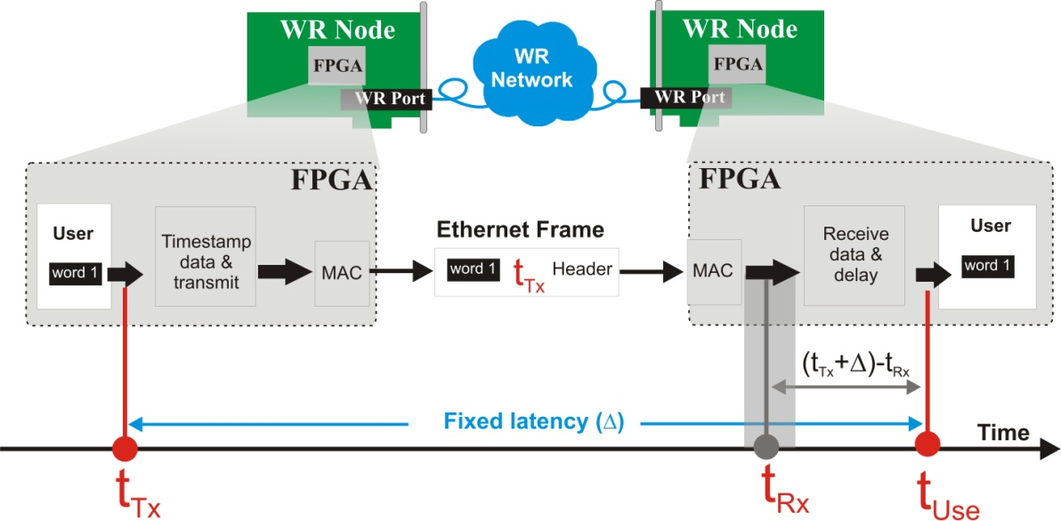
BTrain over White Rabbit Project
FPGA
User logic
B
I
https://gitlab.cern.ch/BTrain-TEAM/Btrain-over-WhiteRabbit/wikis/home
WR PTP Core
WR time and Ethernet Frames
Diagnostics over WR network
WR Streamers
Data Transfer Layer: FIFO over White Rabbit
Statistics of network latency and lost frames
Option to fix latency at configurable value
BTrainFrameTxRx
word
WR Streamers
FIFO
FIFO
WR PTP Core
Latency
WR Switch
FPGA
WR PTP Core
WR Streamers
BTrainFrameTxRx
word
B
I
User logic
9

Slide 39
BTrain over White Rabbit Project
FPGA
User logic
B
I
https://gitlab.cern.ch/BTrain-TEAM/Btrain-over-WhiteRabbit/wikis/home
WR PTP Core
WR time and Ethernet Frames
Diagnostics over WR network
WR Streamers
Data Transfer Layer: FIFO over White Rabbit
Statistics of network latency and lost frames
Option to fix latency at configurable value
BTrainFrameTransceiver
API to the user logic (VHDL records)
Encoding/decoding of BTrain Frames (format agreed by all BTrain users)
Transmission/reception of BTrain frames using WR Streamers
BTrainFrameTxRx
BFrame
WR Streamers
FIFO
FIFO
WR PTP Core
Latency
WR Switch
FPGA
WR PTP Core
WR Streamers
BTrainFrameTxRx
IFrame
B
I
User logic
9

Slide 40
BTrain over White Rabbit Project
FPGA
User logic
B
I
https://gitlab.cern.ch/BTrain-TEAM/Btrain-over-WhiteRabbit/wikis/home
WR PTP Core
WR time and Ethernet Frames
Diagnostics over WR network
WR Streamers
Data Transfer Layer: FIFO over White Rabbit
Statistics of network latency and lost frames
Option to fix latency at configurable value
BTrainFrameTransceiver
API to the user logic (VHDL records)
Encoding/decoding of BTrain Frames (format agreed by all BTrain users)
Transmission/reception of BTrain frames using WR Streamers
Comprehensive documentation and VHDL Reference Designs:
SPEC, SVEC, VFC-HD, VXS boards
BTrainFrameTxRx
BFrame
WR Streamers
FIFO
FIFO
WR PTP Core
Latency
WR Switch
FPGA
WR PTP Core
WR Streamers
BTrainFrameTxRx
IFrame
B
I
User logic
9

Slide 41
Support and monitoring
FPGA
User logic
B
I
Developed by BE-CO-HT, support eventually by TE-MSC-MM
BTrainFrameTxRx
CO-supported
WR Streamers
WR PTP Core
FPGA
WR PTP Core
WR Streamers
Developed by BE-CO-HT, support eventually by TE-MSC-MM
BTrainFrameTxRx
B
I
User logic
10

Slide 42
Support and monitoring
FPGA
User logic
B
I
Developed by BE-CO-HT, support eventually by TE-MSC-MM
BTrainFrameTxRx
CO-supported
Controls Open Source
MOnitoring System
WR Streamers
Monitoring
WR Switch and its ports state
WR Node state
Frames tx/rx/lost
Max/min/avg latency
WR PTP Core
Switch monitoring
over SNMP
WR Switch
Nodes monitoring
over SNMP
FPGA
WR PTP Core
WR NEtwork MOnitoring
and Configuration
WR Streamers
Developed by BE-CO-HT, support eventually by TE-MSC-MM
BTrainFrameTxRx
B
I
User logic
10

Slide 43
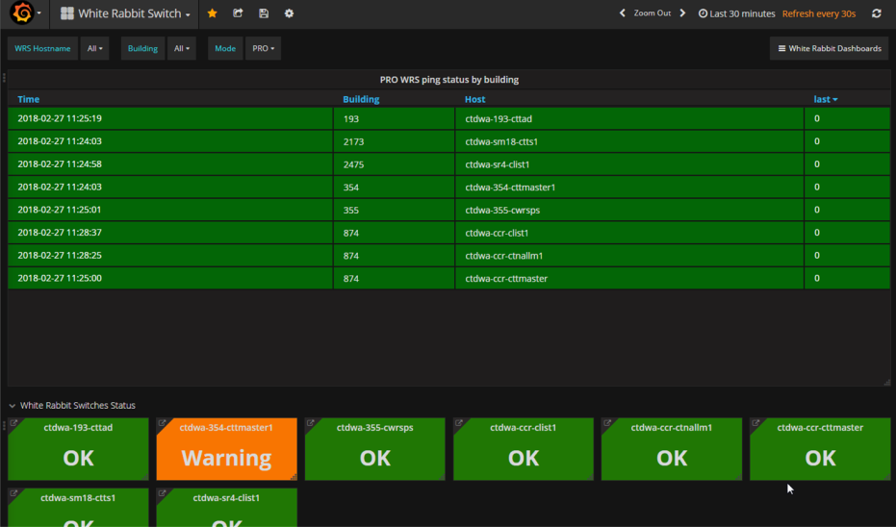
Support and monitoring
FPGA
User logic
B
I
Developed by BE-CO-HT, support eventually by TE-MSC-MM
BTrainFrameTxRx
CO-supported
Controls Open Source
MOnitoring System
WR Streamers
Monitoring
WR Switch and its ports state
WR Node state
Frames tx/rx/lost
Max/min/avg latency
WR PTP Core
Switch monitoring
over SNMP
WR Switch
Nodes monitoring
over SNMP
FPGA
WR PTP Core
WR NEtwork MOnitoring
and Configuration
WR Streamers
Developed by BE-CO-HT, support eventually by TE-MSC-MM
BTrainFrameTxRx
B
I
User logic
10

Slide 44
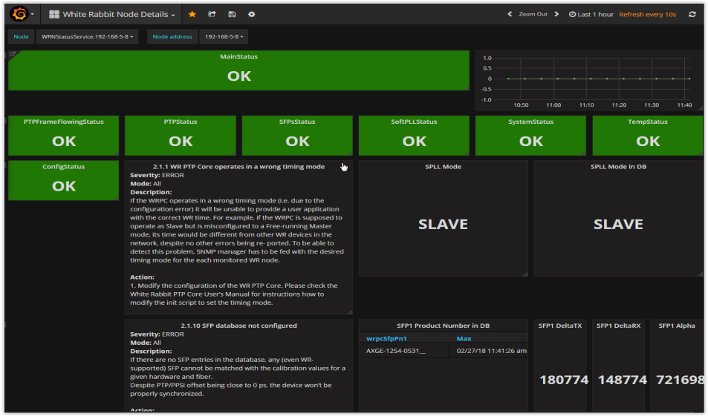
Support and monitoring
FPGA
User logic
B
I
Developed by BE-CO-HT, support eventually by TE-MSC-MM
BTrainFrameTxRx
CO-supported
Controls Open Source
MOnitoring System
WR Streamers
Monitoring
WR Switch and its ports state
WR Node state
Frames tx/rx/lost
Max/min/avg latency
WR PTP Core
Switch monitoring
over SNMP
WR Switch
Nodes monitoring
over SNMP
FPGA
WR PTP Core
WR NEtwork MOnitoring
and Configuration
WR Streamers
Developed by BE-CO-HT, support eventually by TE-MSC-MM
BTrainFrameTxRx
B
I
User logic
10

Slide 45
Status and Plans for BTrain over White Rabbit
Before LS2, successfully used in operation
PS: since 2015
ELENA: since its start – no legacy BTrain
PSB / LEIR: at the end of run 2
After LS2, operational in PSB, LEIR, PS, SPS, AD, ELENA
with the above features included
11

Slide 46
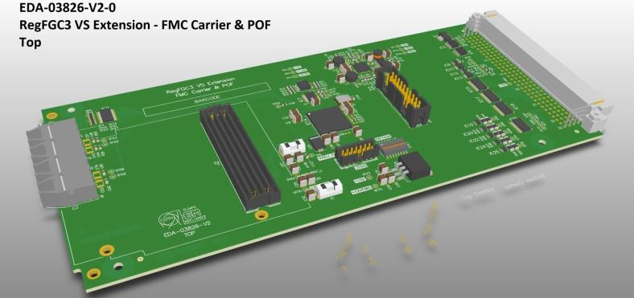
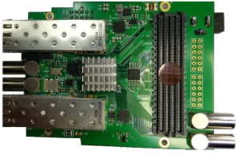
Status and Plans for BTrain over White Rabbit
Before LS2, successfully used in operation
PS: since 2015
ELENA: since its start – no legacy BTrain
PSB / LEIR: at the end of run 2
After LS2, operational in PSB, LEIR, PS, SPS, AD, ELENA
Ongoing work – to be included in next release of BTrain over WhiteRabbit :
WR streamers fixed-latency improved from ± 8ns to sub-ns
Support for Cute-WR-DP FMC
Support for user API on FMC pins
FMC card
FMC carrier
11

Slide 47
Conclusions
BTrain – critical system in PSB, LEIR, PS, SPS, AD, ELENA
White Rabbit – suitable CO-supported technology, versatile and flexible
BTrain over White Rabbit
at the heart of the FIRESTORM project
common interface between all BTrain users
a smooth inter-departament and inter-group collaboration between TE-MSC, TE-EPC, BE-RF, BE-BI facilitated BE-CO.
See: https://wikis.cern.ch/display/HT/Btrain+over+White+Rabbit
12

Slide 48
Conclusions
BTrain – critical system in PSB, LEIR, PS, SPS, AD, ELENA
White Rabbit – suitable CO-supported technology, versatile and flexible
BTrain over White Rabbit
at the heart of the FIRESTORM project
common interface between all BTrain users
a smooth inter-departament and inter-group collaboration between TE-MSC, TE-EPC, BE-RF, BE-BI facilitated BE-CO.
Thank you !
See: https://wikis.cern.ch/display/HT/Btrain+over+White+Rabbit
12

Slide 49
Outline
WR in a nutshell
BTrain over WR (Maciej)
WR Trigger Distribution (Dimitris)
RF Signal Distribution over WR (John)
Q&A

Slide 50
Backup slides

Slide 51
BTrain over WR network and its configuration
The same architecture/config for all accelerators
Two redundant control chains: operational and spare
VLANs used extensively to enforce proper flow of information
See: https://wikis.cern.ch/display/HT/Btrain+over+White+Rabbit

