Slide 1
White Rabbit Applications
John Gill, Dimitris Lampridis, Maciej Lipinski
CERN BE-CO
Hardware and Timing Section
BE-CO (virtual) Technical Meeting
14 May 2020

Slide 2
Outline
Introduction to WR and overview of its applications
BTrain over WR (Maciej)
WR Trigger Distribution (Dimitris)
RF Signal Distribution over WR (John)
Q&A
2

Slide 3
Outline
Introduction to WR and overview of its applications
BTrain over WR (Maciej)
WR Trigger Distribution (Dimitris)
RF Signal Distribution over WR (John)
Q&A
2

Slide 4

White Rabbit in a nutshell
CERN and GSI initiative for control & timing
3

Slide 5
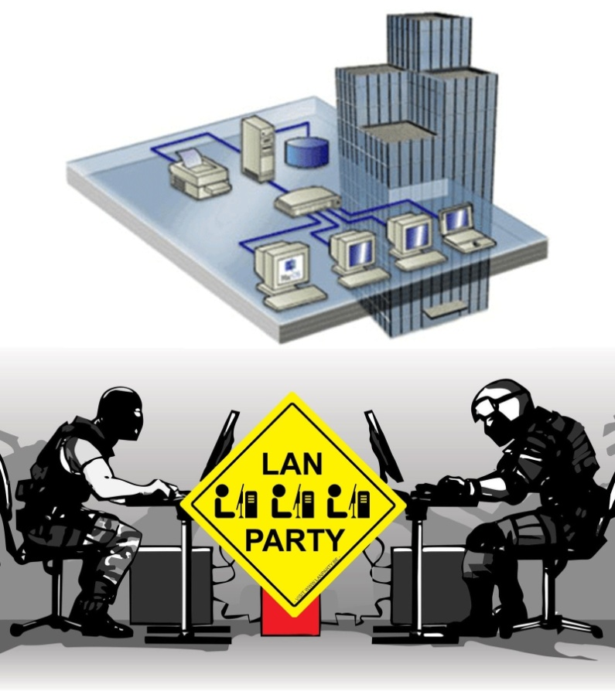
White Rabbit in a nutshell
CERN and GSI initiative for control & timing
Based on well-established standards
  Ethernet (IEEE 802.3)
  Bridged Local Area Network (IEEE 802.1Q)
3

Slide 6
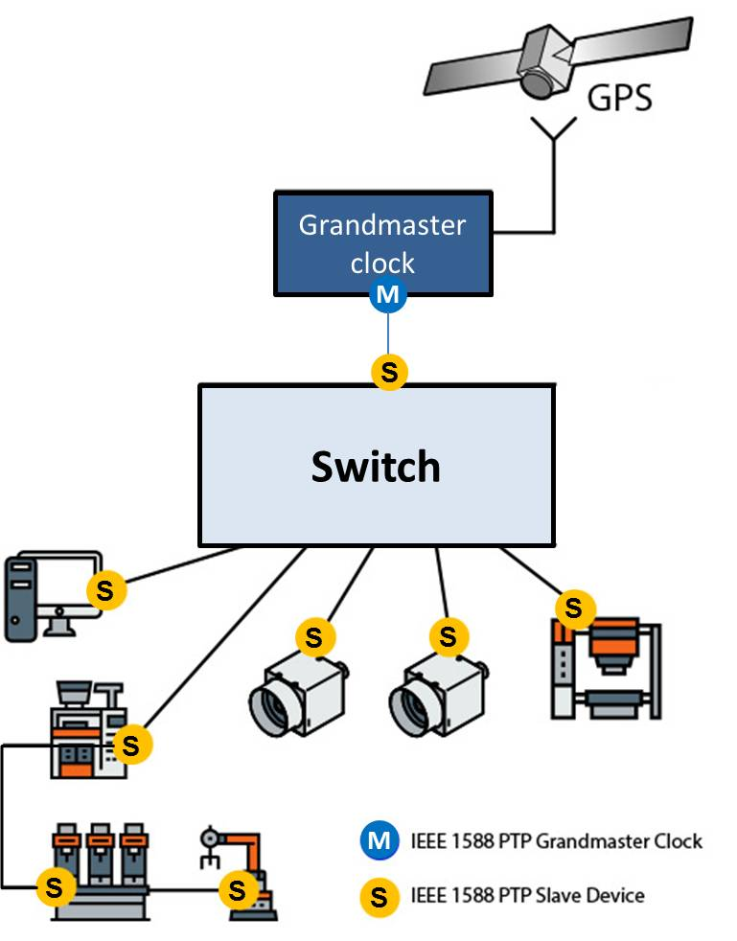
White Rabbit in a nutshell
CERN and GSI initiative for control & timing
Based on well-established standards
  Ethernet (IEEE 802.3)
  Bridged Local Area Network (IEEE 802.1Q)
  Precision Time Protocol (IEEE 1588)
3

Slide 7
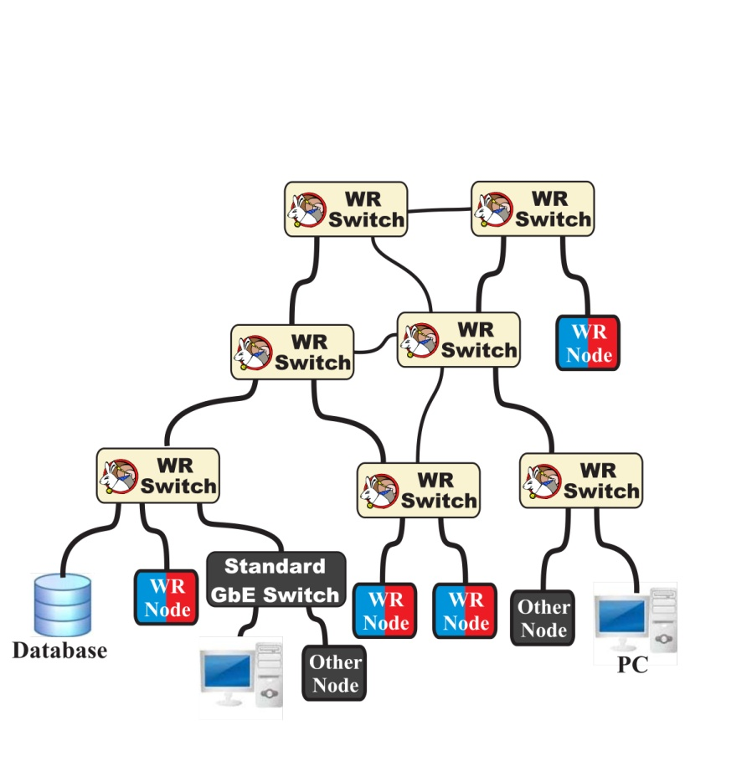
White Rabbit in a nutshell
CERN and GSI initiative for control & timing
Based on well-established standards
  Ethernet (IEEE 802.3)
  Bridged Local Area Network (IEEE 802.1Q)
  Precision Time Protocol (IEEE 1588)
3

Slide 8
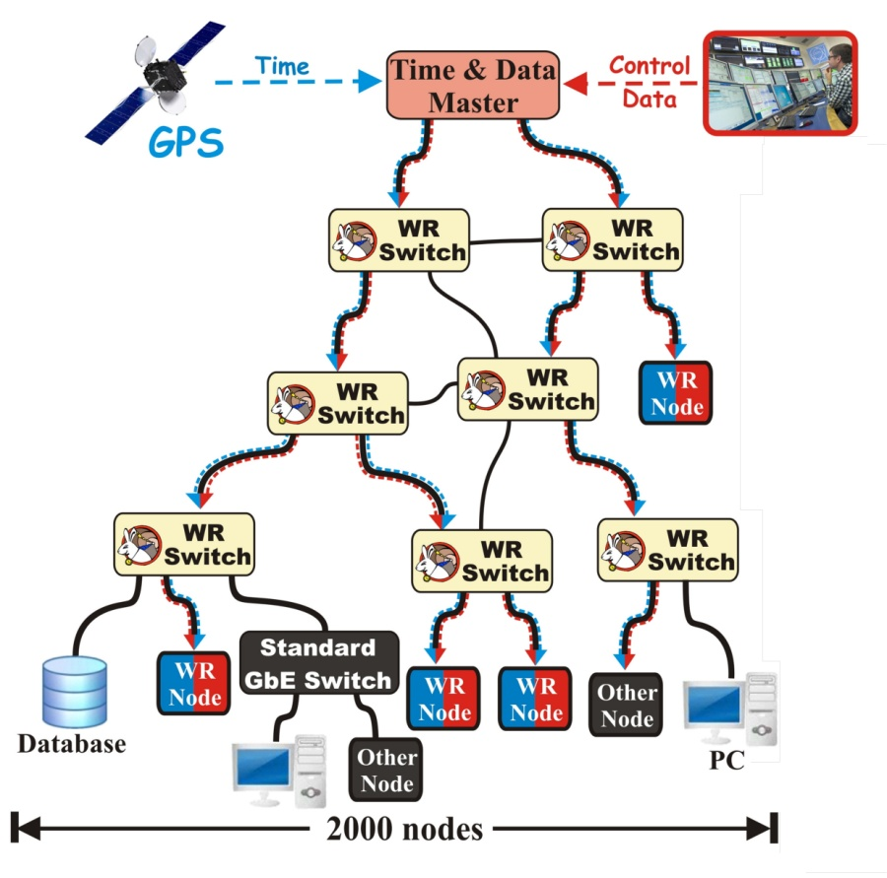
White Rabbit in a nutshell
CERN and GSI initiative for control & timing
Based on well-established standards
  Ethernet (IEEE 802.3)
  Bridged Local Area Network (IEEE 802.1Q)
  Precision Time Protocol (IEEE 1588)
Extends standards to provide
  Sub-ns synchronisation
  Deterministic data transfer
3

Slide 9
White Rabbit in a nutshell
CERN and GSI initiative for control & timing
Based on well-established standards
  Ethernet (IEEE 802.3)
  Bridged Local Area Network (IEEE 802.1Q)
  Precision Time Protocol (IEEE 1588)
Extends standards to provide
  Sub-ns synchronisation (included in IEEE 1588)
  Deterministic data transfer
3

Slide 10
White Rabbit in a nutshell
CERN and GSI initiative for control & timing
Based on well-established standards
  Ethernet (IEEE 802.3)
  Bridged Local Area Network (IEEE 802.1Q)
  Precision Time Protocol (IEEE 1588)
Extends standards to provide
  Sub-ns synchronisation (included in IEEE 1588)
  Deterministic data transfer
Initial specs: links ≤10 km & ≤2000 nodes
<10km
3

Slide 11
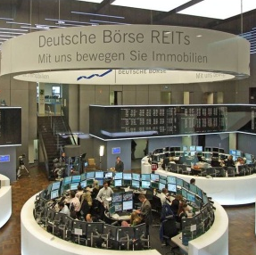
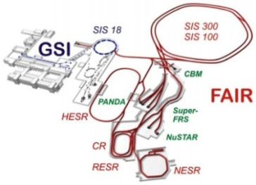

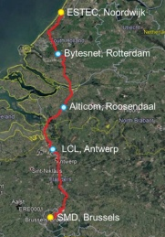

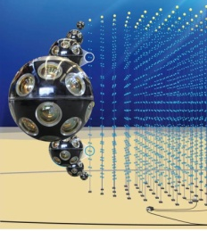

White Rabbit in a nutshell
CERN and GSI initiative for control & timing
Based on well-established standards
  Ethernet (IEEE 802.3)
  Bridged Local Area Network (IEEE 802.1Q)
  Precision Time Protocol (IEEE 1588)
Extends standards to provide
  Sub-ns synchronisation (included in IEEE 1588)
  Deterministic data transfer
Initial specs: links ≤10 km & ≤2000 nodes
Many applications worldwide
CERN & GSI
Accelerator Facilities
German Stock Exchange
National Time Labs
(NL, FI, FR, US, UK, IT)
European Space Agency
for Galileo
Large High Altitude Air
Shower Observatory
Cubic Kilometre
Neutrino Telescope
Telecommunication for
High Accuracy Time Dissemination
http://www.ohwr.org/projects/white-rabbit/wiki/WRUsers
3

Slide 12
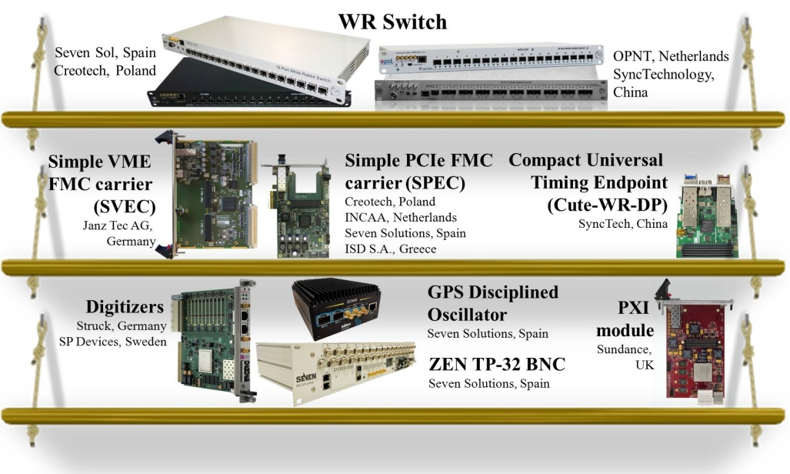
White Rabbit in a nutshell
CERN and GSI initiative for control & timing
Based on well-established standards
  Ethernet (IEEE 802.3)
  Bridged Local Area Network (IEEE 802.1Q)
  Precision Time Protocol (IEEE 1588)
Extends standards to provide
  Sub-ns synchronisation (included in IEEE 1588)
  Deterministic data transfer
Initial specs: links ≤10 km & ≤2000 nodes
Many applications worldwide
Open Source and commercially available
3

Slide 13
White Rabbit in a nutshell
CERN and GSI initiative for control & timing
Based on well-established standards
  Ethernet (IEEE 802.3)
  Bridged Local Area Network (IEEE 802.1Q)
  Precision Time Protocol (IEEE 1588)
Extends standards to provide
  Sub-ns synchronisation (included in IEEE 1588)
  Deterministic data transfer
Initial specs: links ≤10 km & ≤2000 nodes
Many applications worldwide
Open Source and commercially available
More in “Introduction to WR Technologies”
https://indico.cern.ch/event/862562/
3

Slide 14
White Rabbit Applications
Time & frequency transfer
Time-based control
Precise timestamping
Trigger distribution (Dimitris)
Fixed-latency data transfer (Maciej)
Radio-frequency transfer (John)
4

Slide 15
White Rabbit Applications
Time & frequency transfer
Time-based control
Precise timestamping
Trigger distribution (Dimitris)
Fixed-latency data transfer (Maciej)
Radio-frequency transfer (John)
4

Slide 16
Time & frequency transfer
Widely used/evaluated by National Time Labs (5 countries)
5

Slide 17
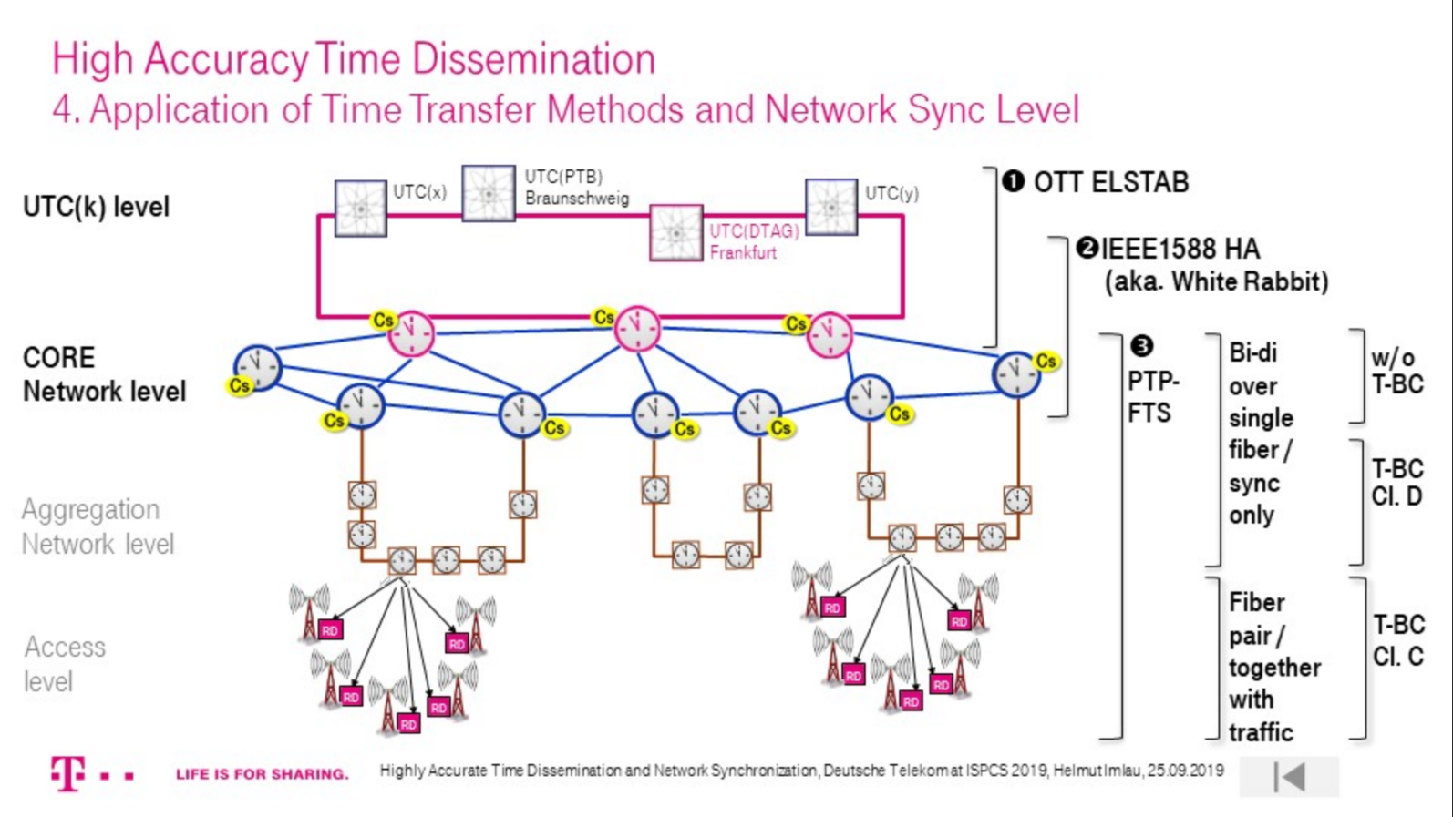
Time & frequency transfer
Widely used/evaluated by National Time Labs (5 countries)
ISPCS keynote Highly Accurate Time Dissemination & Network Synchronisation, Helmut Imlau, Deutsche Telekom
5

Slide 18
White Rabbit Applications
Time & frequency transfer
Time-based control
Precise timestamping
Trigger distribution
Fixed-latency data transfer
Radio-frequency transfer

Slide 19
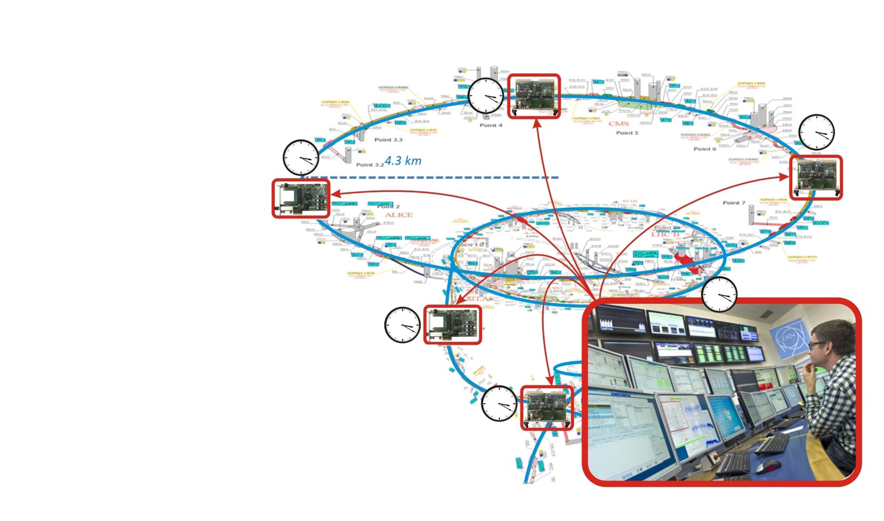
Time-based control
6

Slide 20
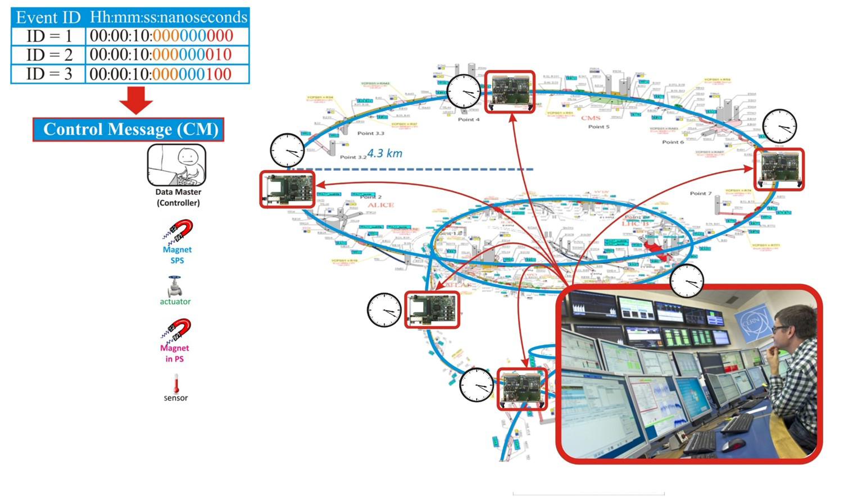
Time-based control
6

Slide 21
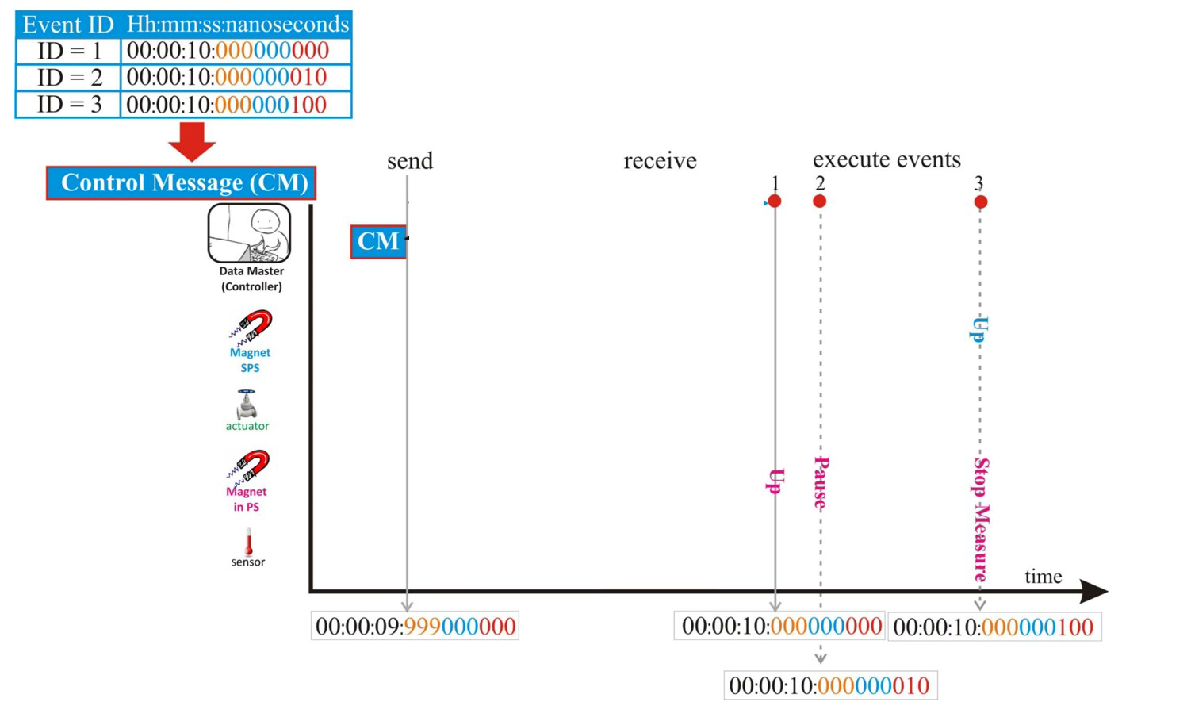
Time-based control
6

Slide 22
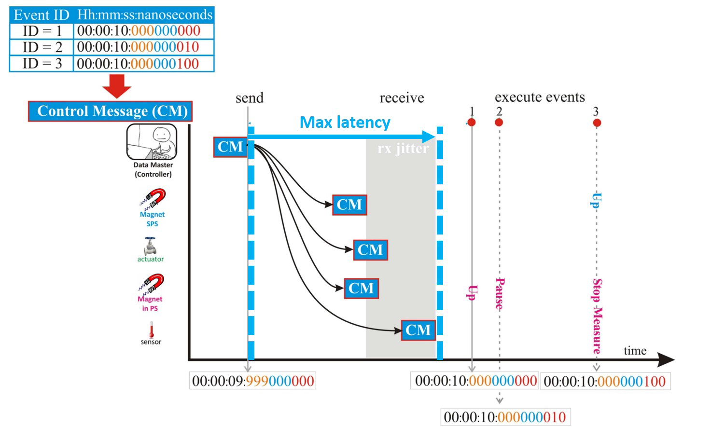
Time-based control
6

Slide 23

Time-based control
GSI Heavy Ion Research in Germany
1-5 ns accuracy and 10 ps precision
WR network at GSI:
  Operational since June 2018:
  134 nodes & 32 switches
  Final: 2000 WR nodes
  & 300 switches in 5 layers
7

Slide 24
White Rabbit Applications
Time & frequency transfer
Time-based control
Precise timestamping
Trigger distribution
Fixed-latency data transfer
Radio-frequency transfer

Slide 25
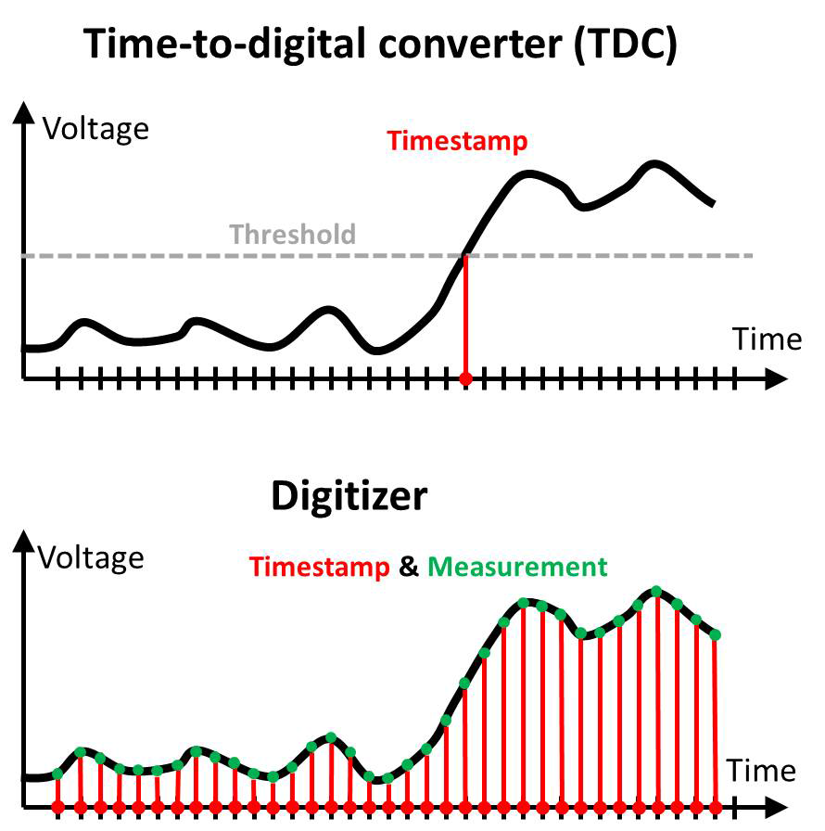
Precise timestamping
Association of time with
  an event
  a sample (measured value)
The most widely used WR application
  Time-of-flight measurement
    Speed of neutrinos - CNGS
    Types of particles - ProtoDUNE
  Cosmic ray and neutrino detection
    Large High Altitude Air Shower Observatory
    Cubic Kilometre Neutrino Telescope
    Tunka Advanced Instrument for cosmic ray physics and Gamma Astronomy
  High Frequency Trade monitoring
    German Stock Exchange
8

Slide 26
Precise timestamping
Association of time with
  an event
  a sample (measured value)
The most widely used WR application
  Time-of-flight measurement
    Speed of neutrinos - CNGS
    Types of particles - ProtoDUNE
  Cosmic ray and neutrino detection
    Large High Altitude Air Shower Observatory
    Cubic Kilometre Neutrino Telescope
    Tunka Advanced Instrument for cosmic ray physics and Gamma Astronomy
  High Frequency Trade monitoring
    German Stock Exchange
8

Slide 27
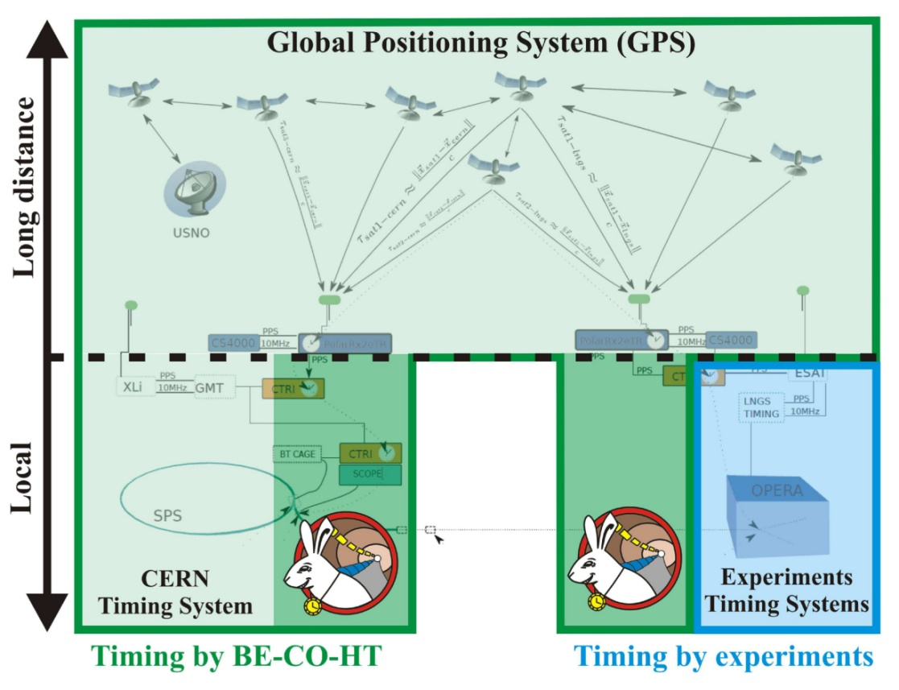
Precise timestamping
Association of time with
  an event
  a sample (measured value)
The most widely used WR application
  Time-of-flight measurement
    Speed of neutrinos - CNGS
    Types of particles - ProtoDUNE
  Cosmic ray and neutrino detection
    Large High Altitude Air Shower Observatory
    Cubic Kilometre Neutrino Telescope
    Tunka Advanced Instrument for cosmic ray physics and Gamma Astronomy
  High Frequency Trade monitoring
    German Stock Exchange
8

Slide 28
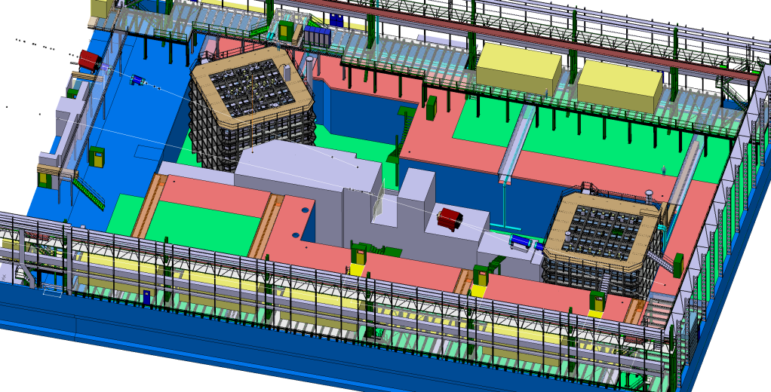
Precise timestamping
Association of time with
  an event
  a sample (measured value)
The most widely used WR application
  Time-of-flight measurement
    Speed of neutrinos - CNGS
    Types of particles - ProtoDUNE
  Cosmic ray and neutrino detection
    Large High Altitude Air Shower Observatory
    Cubic Kilometre Neutrino Telescope
    Tunka Advanced Instrument for cosmic ray physics and Gamma Astronomy
  High Frequency Trade monitoring
    German Stock Exchange
8

Slide 29
Precise timestamping
Association of time with
  an event
  a sample (measured value)
The most widely used WR application
  Time-of-flight measurement
    Speed of neutrinos - CNGS
    Types of particles - ProtoDUNE
  Cosmic ray and neutrino detection
    Large High Altitude Air Shower Observatory
    Cubic Kilometre Neutrino Telescope
    Tunka Advanced Instrument for cosmic ray physics and Gamma Astronomy
  High Frequency Trade monitoring
    German Stock Exchange
8

Slide 30
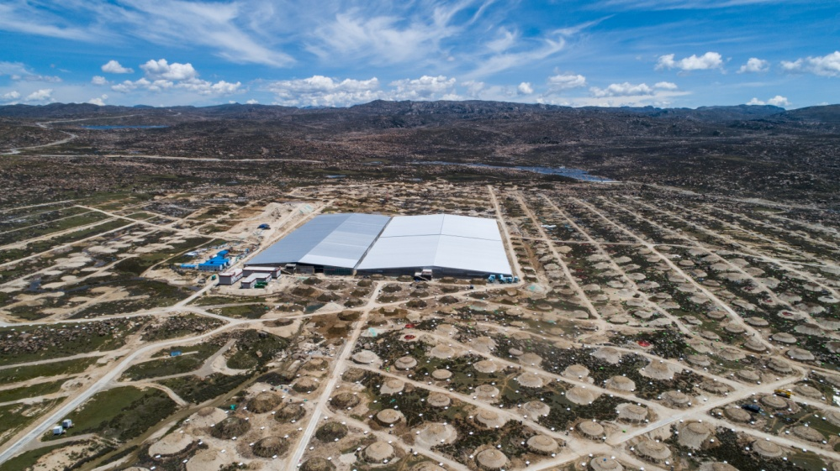
Precise timestamping
Association of time with
  an event
  a sample (measured value)
The most widely used WR application
  Time-of-flight measurement
    Speed of neutrinos - CNGS
    Types of particles - ProtoDUNE
  Cosmic ray and neutrino detection
    Large High Altitude Air Shower Observatory
    Cubic Kilometre Neutrino Telescope
    Tunka Advanced Instrument for cosmic ray physics and Gamma Astronomy
  High Frequency Trade monitoring
    German Stock Exchange
8

Slide 31
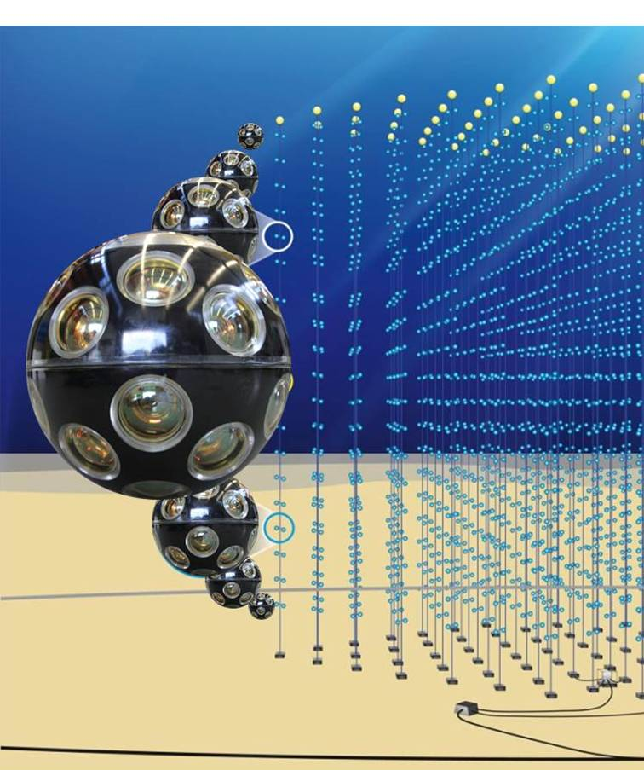
Precise timestamping
Association of time with
  an event
  a sample (measured value)
The most widely used WR application
  Time-of-flight measurement
    Speed of neutrinos - CNGS
    Types of particles - ProtoDUNE
  Cosmic ray and neutrino detection
    Large High Altitude Air Shower Observatory
    Cubic Kilometre Neutrino Telescope
    Tunka Advanced Instrument for cosmic ray physics and Gamma Astronomy
  High Frequency Trade monitoring
    German Stock Exchange
8

Slide 32
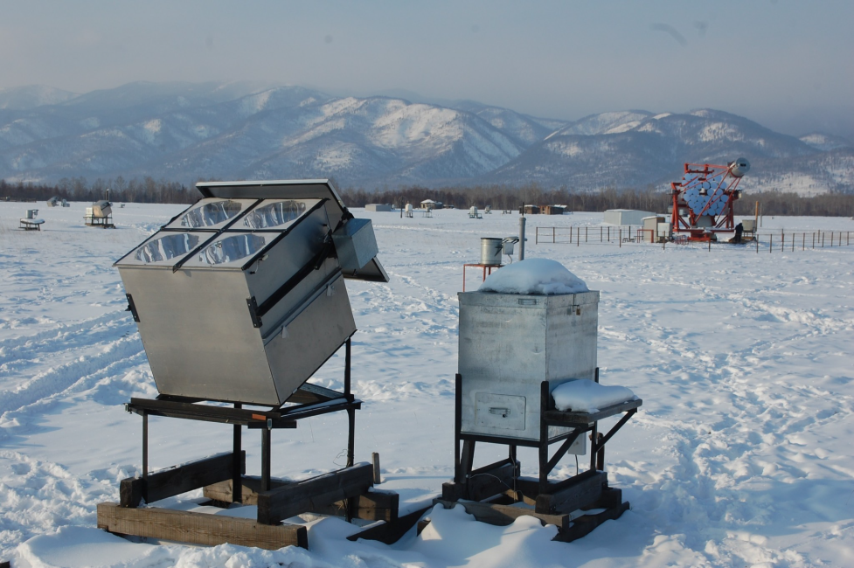
Precise timestamping
Association of time with
  an event
  a sample (measured value)
The most widely used WR application
  Time-of-flight measurement
    Speed of neutrinos - CNGS
    Types of particles - ProtoDUNE
  Cosmic ray and neutrino detection
    Large High Altitude Air Shower Observatory
    Cubic Kilometre Neutrino Telescope
    Tunka Advanced Instrument for cosmic ray physics and Gamma Astronomy
  High Frequency Trade monitoring
    German Stock Exchange
8

Slide 33
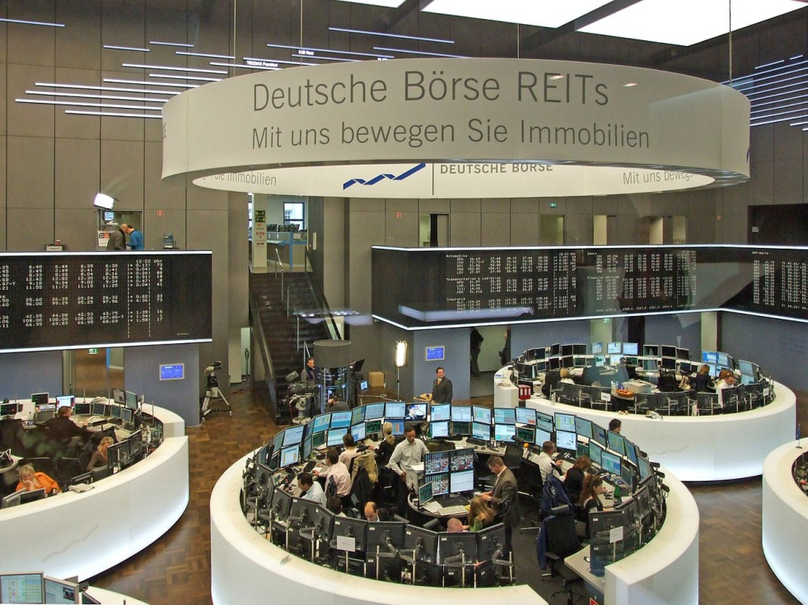
Precise timestamping
Association of time with
  an event
  a sample (measured value)
The most widely used WR application
  Time-of-flight measurement
    Speed of neutrinos - CNGS
    Types of particles - ProtoDUNE
  Cosmic ray and neutrino detection
    Large High Altitude Air Shower Observatory
    Cubic Kilometre Neutrino Telescope
    Tunka Advanced Instrument for cosmic ray physics and Gamma Astronomy
  High Frequency Trade monitoring
    German Stock Exchange
8

Slide 34
White Rabbit Applications
Time & frequency transfer
Time-based control
Precise timestamping
Trigger distribution
Fixed-latency data transfer
Radio-frequency transfer

Slide 35
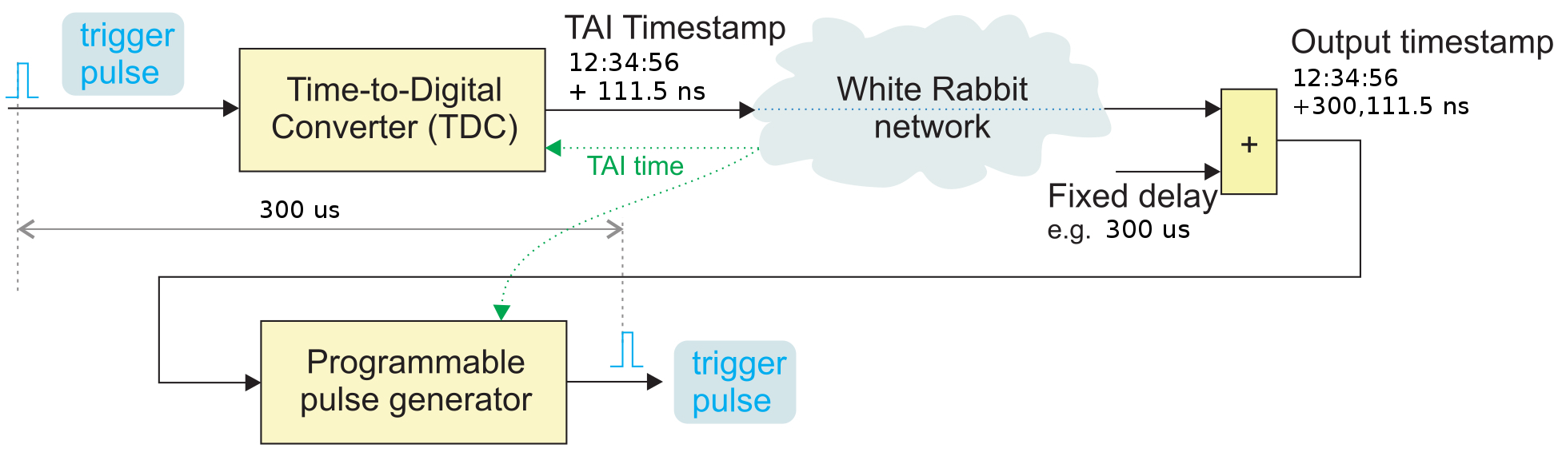
Trigger distribution
9

Slide 36
Trigger distribution
LHC trigger distribution to measure beam instabilities - since 2016
WRTD - White Rabbit Trigger Distribution (next presentation) to be used for CERN’s Open Analog Signals Information System (OASIS)
9

Slide 37
White Rabbit Applications
Time & frequency transfer
Time-based control
Precise timestamping
Trigger distribution
Fixed-latency data transfer
Radio-frequency transfer

Slide 38
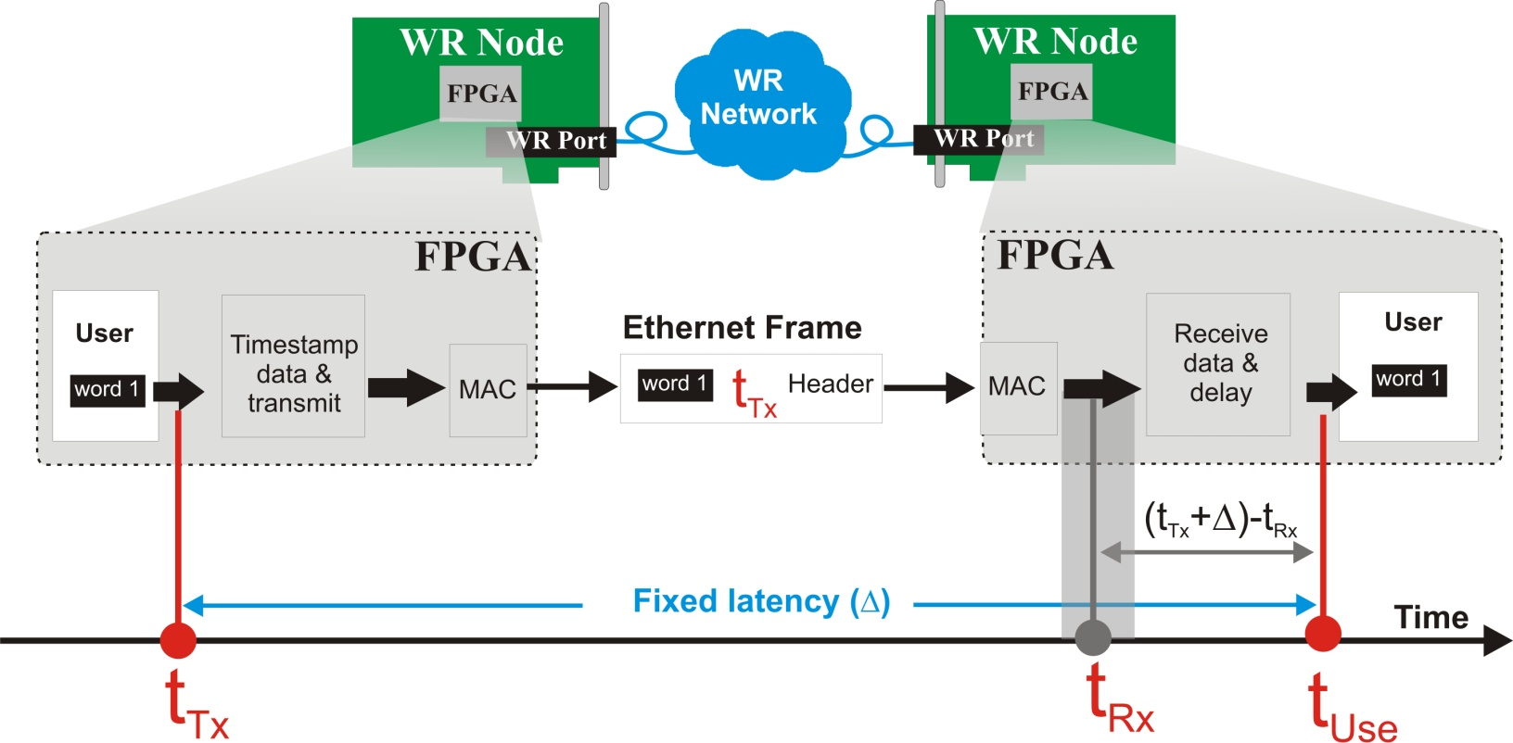
Fixed-latency data transfer
10

Slide 39
Fixed-latency data transfer
Distribution of magnetic field in CERN accelerators (BTrain over WR, discussed later)
Distribution of RF signal for LLRF in SPS
10

Slide 40
White Rabbit Applications
Time & frequency transfer
Time-based control
Precise timestamping
Trigger distribution
Fixed-latency data transfer
Radio-frequency transfer

Slide 41
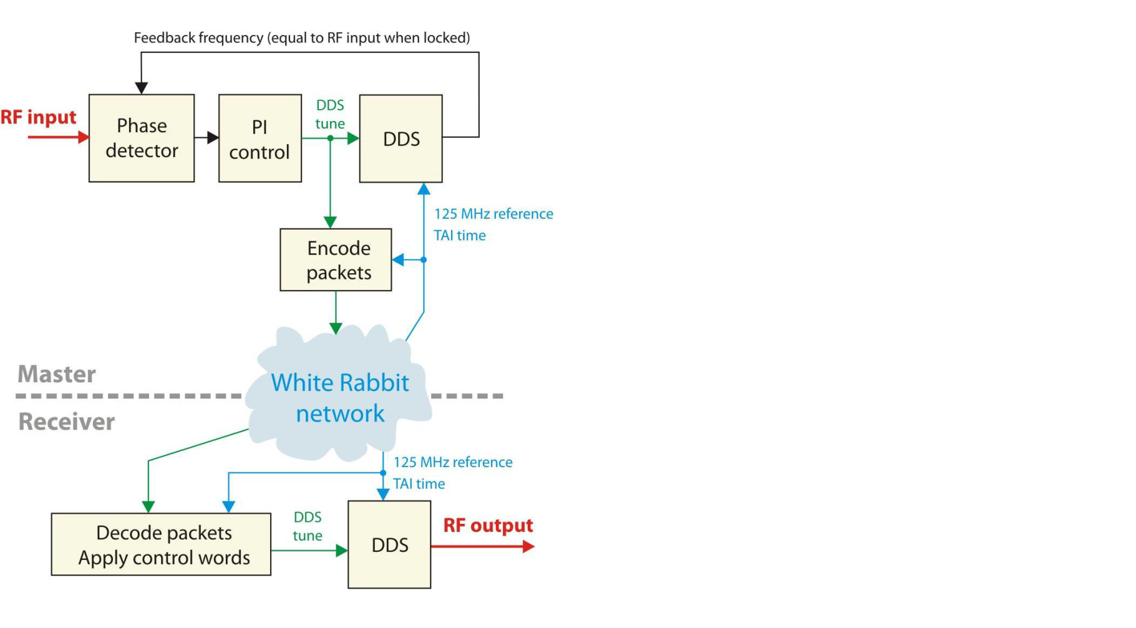
Radio-frequency transfer
11

Slide 42
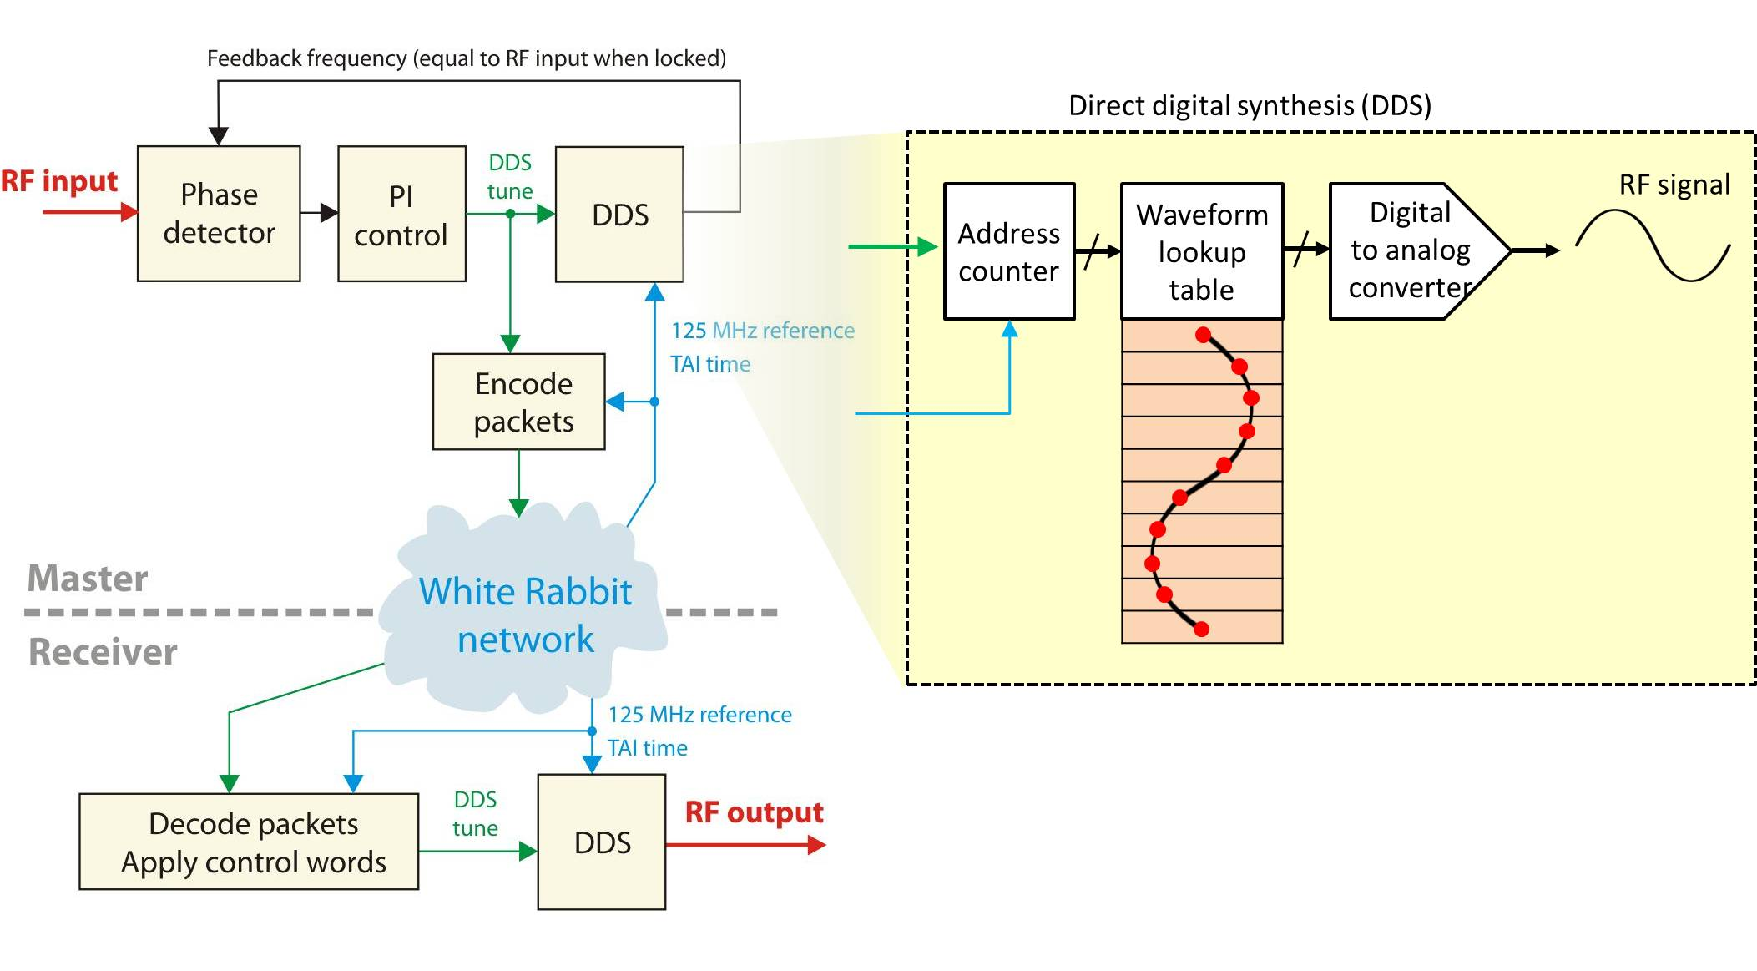
Radio-frequency transfer
11

Slide 43
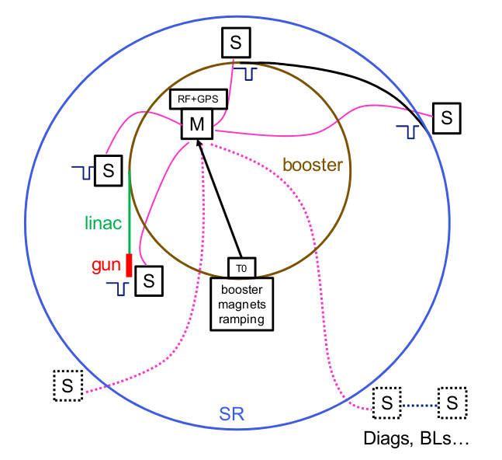
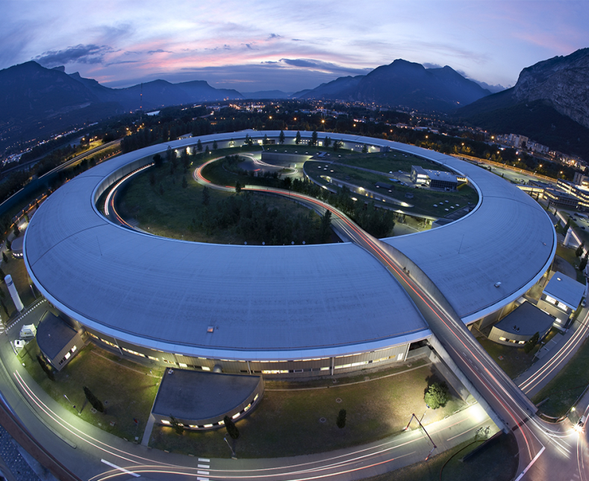
Radio-frequency transfer
RF over WR at European Synchrotron Radiation Facility (ESRF)
  A prototype tested in operation: <10 ps jitter
RF over WR at CERN (next presentation)
  A prototype: <100 fs jitter and <10 ps reproducibility over reboots
12

Slide 44
Outline
WR in a nutshell and overview of its applications
BTrain over WR (Maciej)
WR Trigger Distribution (Dimitris)
RF Signal Distribution over WR (John)
Q&A

Slide 45
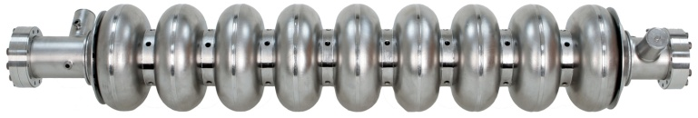
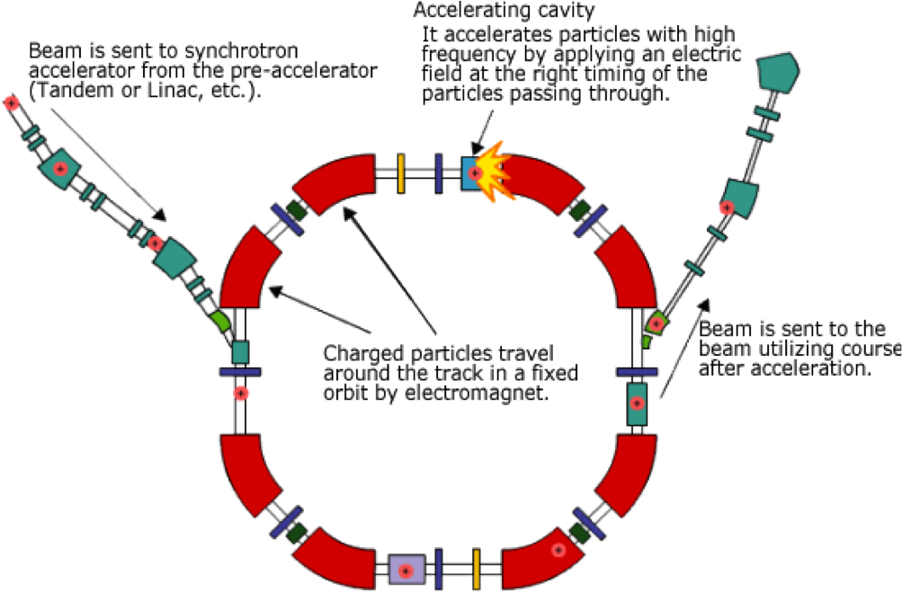
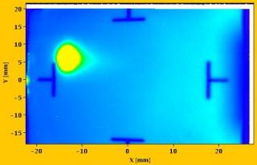
Synchrotron operation
Bending
magnet
B (t)
Coordination required between:
f (t) – RF in accelerating cavities
B(t) – magnetic field in bending magnets
I(t) – current provided by power converters
Beam Instrumentation diagnostics
I(t)
f_{rev} (t)
V
Beam Inst.
Diagnostics
Accelerating
RF cavity
Power
converter
13

Slide 46
Synchrotron operation
Bending
magnet
B (t)
Coordination required between:
f (t) – RF in accelerating cavities
B(t) – magnetic field in bending magnets
I(t) – current provided by power converters
Beam Instrumentation diagnostics
Coordination provided by
the BTrain system
I(t)
f_{rev} (t)
V
Beam Inst.
Diagnostics
Accelerating
RF cavity
Power
converter
13

Slide 47
BTrain System
Bending
magnet
B (t)
I(t)
f_{rev} (t)
V
Beam Inst.
Diagnostics
Accelerating
RF cavity
Power
converter
14

Slide 48


BTrain System
Bending
magnet
B (t)
I(t)
B
B
B
f_{rev} (t)
V
Beam Inst.
Diagnostics
Accelerating
RF cavity
Power
converter
14

Slide 49

BTrain System
Bending
magnet
B (t)
1us
0.1 Gauss =
(max 500kHz)
24V
I(t)
B
B
B
f_{rev} (t)
V
Beam Inst.
Diagnostics
Accelerating
RF cavity
Power
converter
14

Slide 50
BTrain System
Bending
magnet
B (t)
marker 2 (optional)
B_{flat top}
B(t)
coil measurement
V_{coil} ~ Ḃ
I(t)
Peaking strip
marker 1
B
B
B
B_{flat bottom}
f_{rev} (t)
t₁
t₂
time
V
Beam Inst.
Diagnostics
Accelerating
RF cavity
Power
converter
14

Slide 51
BTrain System
Bending
magnet
B (t)
marker 2 (optional)
B_{flat top}
B(t)
coil measurement
V_{coil} ~ Ḃ
I(t)
Peaking strip
marker 1
B
B
B
B_{flat bottom}
f_{rev} (t)
t₁
t₂
time
preset B(t₁)
+0.1G
B(t)
V
- 0.1G
Beam Inst.
Diagnostics
Accelerating
RF cavity
Power
converter
14

Slide 52
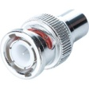
BTrain System
Bending
magnet
B (t)
marker 2 (optional)
B_{flat top}
B(t)
coil measurement
V_{coil} ~ Ḃ
I(t)
Peaking strip
marker 1
B
B
B
B_{flat bottom}
f_{rev} (t)
t₁
t₂
time
preset B(t₁)
+0.1G
B(t)
V
- 0.1G
~ V_{coil}
Beam Inst.
Diagnostics
Accelerating
RF cavity
Power
converter
14

Slide 53
FIRESTORM to renovate BTrain
Bending
magnet
B (t)
Project by Magnets, Superconductors & Cryostats (TE-MSC) Group in collaboration with TE-EPC, BE-RF, BE-BI & BE-CO.
Why to renovate:
Higher resolution (0.05G) required in PS
Peak slope of 6T/s required by PSB
Spikes & noise on Bdot, timing problems with marker
Obsolete measurement technology and aging components
Non-standard equipment, little support from CO
Not uniform across accelerators & limited diagnostics
What to renovate:
Measurement technology – new markers and coils
Data transfer technology – White Rabbit
I(t)
B
B
B
f_{rev} (t)
V
Beam Inst.
Diagnostics
Accelerating
RF cavity
Power
converter
15

Slide 54

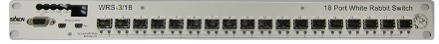
FIRESTORM to renovate BTrain
Bending
magnet
B (t)
Project by Magnets, Superconductors & Cryostats (TE-MSC) Group in collaboration with TE-EPC, BE-RF, BE-BI & BE-CO.
Why to renovate:
Higher resolution (0.05G) required in PS
Peak slope of 6T/s required by PSB
Spikes & noise on Bdot, timing problems with marker
Obsolete measurement technology and aging components
Non-standard equipment, little support from CO
Not uniform across accelerators & limited diagnostics
What to renovate:
Measurement technology – new markers and coils
Data transfer technology – White Rabbit
WR Node
I(t)
WR Switch
f_{rev} (t)
V
Beam Inst.
Diagnostics
Accelerating
RF cavity
Power
converter
15

Slide 55
BTrain data transfer over WR
Bending
magnet
B (t)
I(t)
WR Switch
f_{rev} (t)
V
Beam Inst.
Diagnostics
Accelerating
RF cavity
Power
converter
16

Slide 56
BTrain data transfer over WR
Bending
magnet
B (t)
Digitally distributes absolute values of B and Bdot
in Ethernet frames
Distributes simultaneously B from different sources
(old B, measured B, simulated B, synthesized B)
Provides additional control information (C0, marker)
Supports resolution down to 0.0001G
Allows rates >500kHz and infinitely fast ramps
Deterministic & guarantees max latency of 10us
Provides extensive diagnostics
Provides flexibility and scalability
  I(t) is sent back for model analysis
Payload of Ethernet Frame
CTRL | B | Bdot | oldB | meaB | simB | synB
CTRL
I
I(t)
WR Switch
f_{rev} (t)
V
Beam Inst.
Diagnostics
Accelerating
RF cavity
Power
converter
16

Slide 57

BTrain data transfer over WR
Bending
magnet
B (t)
Digitally distributes absolute values of B and Bdot
in Ethernet frames
Distributes simultaneously B from different sources
(old B, measured B, simulated B, synthesized B)
Provides additional control information (C0, marker)
Supports resolution down to 0.0001G
Allows rates >500kHz and infinitely fast ramps
Deterministic & guarantees max latency of 10us
Provides extensive diagnostics
Provides flexibility and scalability
  I(t) is sent back for model analysis
  I(t) exchanged internally for Pole Face
  Winding (PFW) of Power Converters
Payload of Ethernet Frame
CTRL | B | Bdot | oldB | meaB | simB | synB
CTRL
I
I(t)
WR Switch
f_{rev} (t)
V
Beam Inst.
Diagnostics
Accelerating
RF cavity
Power
converter
16

Slide 58
BTrain data transfer over WR
Bending
magnet
B (t)
Digitally distributes absolute values of B and Bdot
in Ethernet frames
Distributes simultaneously B from different sources
(old B, measured B, simulated B, synthesized B)
Provides additional control information (C0, marker)
Supports resolution down to 0.0001G
Allows rates >500kHz and infinitely fast ramps
Deterministic & guarantees max latency of 10us
Provides extensive diagnostics
Provides flexibility and scalability
  I(t) is sent back for model analysis
  I(t) exchanged internally for Pole Face
  Winding (PFW) of Power Converters
Payload of Ethernet Frame
CTRL | B | Bdot | oldB | meaB | simB | synB
CTRL
I
I(t)
WR Switch
f_{rev} (t)
SPS RF
V
  NOTE: Accelerating RF cavities to be
  controlled in SPS using WR
Beam Inst.
Diagnostics
Accelerating
RF cavity
Power
converter
16

Slide 59
WR-BTrain Nodes
Bending
magnet
B (t)
I(t)
WR Switch
f_{rev} (t)
V
Beam Inst.
Diagnostics
Accelerating
RF cavity
Power
converter
17

Slide 60
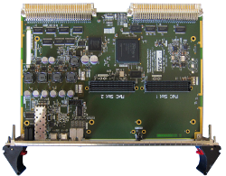
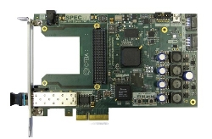
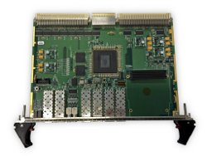
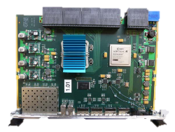
WR-BTrain Nodes
Bending
magnet
B (t)
Simple
VME64x
FMC Carrier
(SVEC)
Simple PCIe
FMC carrier
(SPEC)
VME FMC
Carrier
HPC-DDR3
(VFC-HD)
VXS
Switch
FPGA
I(t)
FPGA
WR Switch
FPGA
f_{rev} (t)
V
FPGA
Beam Inst.
Diagnostics
Accelerating
RF cavity
Power
converter
17

Slide 61
WR-BTrain Nodes
Bending
magnet
B (t)
Simple
VME64x
FMC Carrier
(SVEC)
Simple PCIe
FMC carrier
(SPEC)
VME FMC
Carrier
HPC-DDR3
(VFC-HD)
VXS
Switch
FPGA
CO-supported
hardware
I(t)
FPGA
WR Switch
FPGA
f_{rev} (t)
V
FPGA
Beam Inst.
Diagnostics
Accelerating
RF cavity
Power
converter
17

Slide 62
WR-BTrain Nodes
Bending
magnet
B (t)
CO-support
for
White
Rabbit
Simple
VME64x
FMC Carrier
(SVEC)
Simple PCIe
FMC carrier
(SPEC)
VME FMC
Carrier
HPC-DDR3
(VFC-HD)
VXS
Switch
FPGA
I(t)
FPGA
WR Switch
FPGA
f_{rev} (t)
V
FPGA
Beam Inst.
Diagnostics
Accelerating
RF cavity
Power
converter
17

Slide 63
BTrain over White Rabbit Project
FPGA
User logic
B
I
https://gitlab.cern.ch/BTrain-TEAM/Btrain-over-WhiteRabbit/wikis/home
BTrain over
White Rabbit
Simple
VME64x
FMC Carrier
(SVEC)
Simple PCIe
FMC carrier
(SPEC)
VME FMC
Carrier
HPC-DDR3
(VFC-HD)
VXS
Switch
FPGA
FPGA
WR Switch
FPGA
FPGA
FPGA
BTrain over
White Rabbit
BTrain over
White Rabbit
BTrain over
White Rabbit
FPGA
B
I
B
I
B
I
User logic
User logic
User logic
FPGA
18

Slide 64
BTrain over White Rabbit Project
FPGA
User logic
B
I
https://gitlab.cern.ch/BTrain-TEAM/Btrain-over-WhiteRabbit/wikis/home
BTrain over
White Rabbit
WR Switch
FPGA
FPGA
FPGA
BTrain over
White Rabbit
BTrain over
White Rabbit
BTrain over
White Rabbit
B
I
B
I
B
I
User logic
User logic
User logic
18

Slide 65
BTrain over White Rabbit Project
FPGA
User logic
B
I
https://gitlab.cern.ch/BTrain-TEAM/Btrain-over-WhiteRabbit/wikis/home
WR PTP Core
WR time and Ethernet Frames
Diagnostics over WR network
WR Streamers
Data Transfer Layer: FIFO over White Rabbit
Statistics of network latency and lost frames
Option to fix latency at configurable value
BTrainFrameTransceiver
API to the user logic (VHDL records)
Encoding/decoding of BTrain Frames
(format agreed by all BTrain users)
Transmission/reception of BTrain frames
using WR Streamers
BTrainFrameTxRx
WR Streamers
WR PTP Core
WR Switch
FPGA
FPGA
FPGA
WR PTP Core
WR PTP Core
WR PTP Core
WR Streamers
WR Streamers
WR Streamers
BTrainFrameTxRx
BTrainFrameTxRx
BTrainFrameTxRx
B
I
B
I
B
I
User logic
User logic
User logic
18

Slide 66
BTrain over White Rabbit Project
FPGA
User logic
B
I
https://gitlab.cern.ch/BTrain-TEAM/Btrain-over-WhiteRabbit/wikis/home
WR PTP Core
WR time and Ethernet Frames
Diagnostics over WR network
WR Streamers
Data Transfer Layer: FIFO over White Rabbit
Statistics of network latency and lost frames
Option to fix latency at configurable value
BTrainFrameTransceiver
API to the user logic (VHDL records)
Encoding/decoding of BTrain Frames
(format agreed by all BTrain users)
Transmission/reception of BTrain frames
using WR Streamers
BTrainFrameTxRx
WR Streamers
WR PTP Core
WR Switch
FPGA
WR PTP Core
WR Streamers
BTrainFrameTxRx
B
I
User logic
18

Slide 67
BTrain over White Rabbit Project
FPGA
User logic
B
I
https://gitlab.cern.ch/BTrain-TEAM/Btrain-over-WhiteRabbit/wikis/home
WR PTP Core
WR time and Ethernet Frames
Diagnostics over WR network
BTrainFrameTxRx
WR Streamers
WR PTP Core
WR Switch
FPGA
WR PTP Core
WR Streamers
BTrainFrameTxRx
B
I
User logic
18

Slide 68
BTrain over White Rabbit Project
FPGA
User logic
B
I
https://gitlab.cern.ch/BTrain-TEAM/Btrain-over-WhiteRabbit/wikis/home
WR PTP Core
WR time and Ethernet Frames
Diagnostics over WR network
WR Streamers
Data Transfer Layer: FIFO over White Rabbit
Statistics of network latency and lost frames
Option to fix latency at configurable value
BTrainFrameTxRx
word
WR Streamers
FIFO
FIFO
WR PTP Core
Latency
WR Switch
FPGA
WR PTP Core
WR Streamers
BTrainFrameTxRx
word
B
I
User logic
18

Slide 69
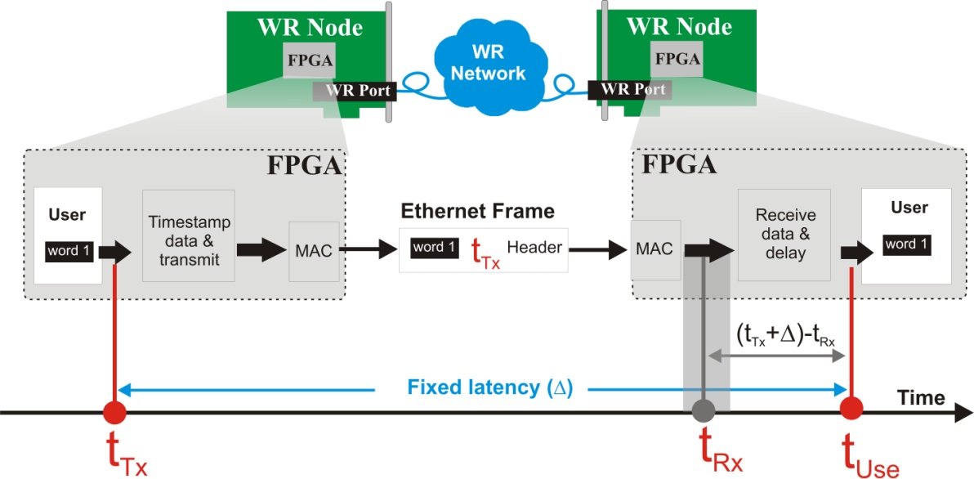
BTrain over White Rabbit Project
FPGA
User logic
B
I
https://gitlab.cern.ch/BTrain-TEAM/Btrain-over-WhiteRabbit/wikis/home
WR PTP Core
WR time and Ethernet Frames
Diagnostics over WR network
WR Streamers
Data Transfer Layer: FIFO over White Rabbit
Statistics of network latency and lost frames
Option to fix latency at configurable value
BTrainFrameTxRx
word
WR Streamers
FIFO
FIFO
WR PTP Core
Latency
WR Switch
FPGA
WR PTP Core
WR Streamers
BTrainFrameTxRx
word
B
I
User logic
18

Slide 70
BTrain over White Rabbit Project
FPGA
User logic
B
I
https://gitlab.cern.ch/BTrain-TEAM/Btrain-over-WhiteRabbit/wikis/home
WR PTP Core
WR time and Ethernet Frames
Diagnostics over WR network
WR Streamers
Data Transfer Layer: FIFO over White Rabbit
Statistics of network latency and lost frames
Option to fix latency at configurable value
BTrainFrameTransceiver
API to the user logic (VHDL records)
Encoding/decoding of BTrain Frames
(format agreed by all BTrain users)
Transmission/reception of BTrain frames
using WR Streamers
BTrainFrameTxRx
BFrame
WR Streamers
FIFO
FIFO
WR PTP Core
Latency
WR Switch
FPGA
WR PTP Core
WR Streamers
BTrainFrameTxRx
IFrame
B
I
User logic
18

Slide 71
BTrain over White Rabbit Project
FPGA
User logic
B
I
https://gitlab.cern.ch/BTrain-TEAM/Btrain-over-WhiteRabbit/wikis/home
WR PTP Core
WR time and Ethernet Frames
Diagnostics over WR network
WR Streamers
Data Transfer Layer: FIFO over White Rabbit
Statistics of network latency and lost frames
Option to fix latency at configurable value
BTrainFrameTransceiver
API to the user logic (VHDL records)
Encoding/decoding of BTrain Frames
(format agreed by all BTrain users)
Transmission/reception of BTrain frames
using WR Streamers
Comprehensive documentation and VHDL Reference Designs:
SPEC, SVEC, VFC-HD, VXS, CUTE-DP-WR boards
BTrainFrameTxRx
BFrame
WR Streamers
FIFO
FIFO
WR PTP Core
Latency
WR Switch
FPGA
WR PTP Core
WR Streamers
BTrainFrameTxRx
IFrame
B
I
User logic
18

Slide 72
Support and monitoring
FPGA
User logic
B
I
Developed by BE-CO-HT, support eventually by TE-MSC-MM
BTrainFrameTxRx
CO-supported
WR Streamers
WR PTP Core
FPGA
WR PTP Core
WR Streamers
Developed by BE-CO-HT, support eventually by TE-MSC-MM
BTrainFrameTxRx
B
I
User logic
19

Slide 73



Support and monitoring
FPGA
User logic
B
I
Developed by BE-CO-HT, support eventually by TE-MSC-MM
BTrainFrameTxRx
CO-supported
Controls Open Source
MOnitoring System
WR Streamers
Monitoring
WR Switch and its ports state
WR Node state
Frames tx/rx/lost
Max/min/avg latency
WR PTP Core
Switch monitoring
over SNMP
WR Switch
Nodes monitoring
over SNMP
FPGA
WR PTP Core
WR NEtwork MOnitoring
and Configuration
WR Streamers
Developed by BE-CO-HT, support eventually by TE-MSC-MM
BTrainFrameTxRx
B
I
User logic
19

Slide 74
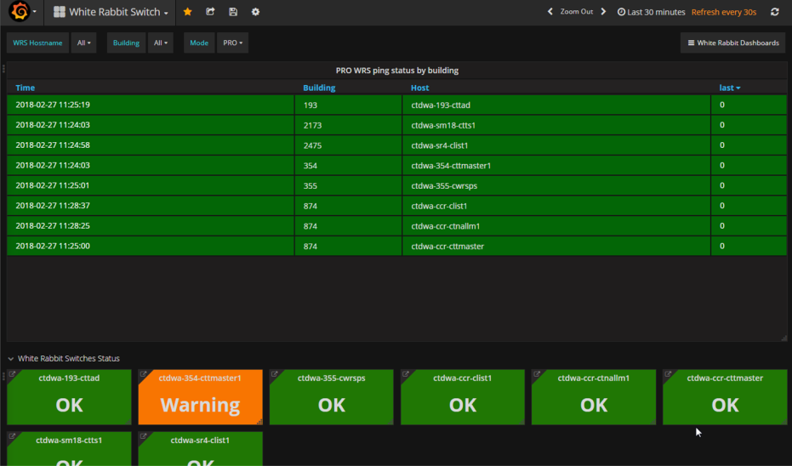
Support and monitoring
FPGA
User logic
B
I
Developed by BE-CO-HT, support eventually by TE-MSC-MM
BTrainFrameTxRx
CO-supported
Controls Open Source
MOnitoring System
WR Streamers
Monitoring
WR Switch and its ports state
WR Node state
Frames tx/rx/lost
Max/min/avg latency
WR PTP Core
Switch monitoring
over SNMP
WR Switch
Nodes monitoring
over SNMP
FPGA
WR PTP Core
WR NEtwork MOnitoring
and Configuration
WR Streamers
Developed by BE-CO-HT, support eventually by TE-MSC-MM
BTrainFrameTxRx
B
I
User logic
19

Slide 75
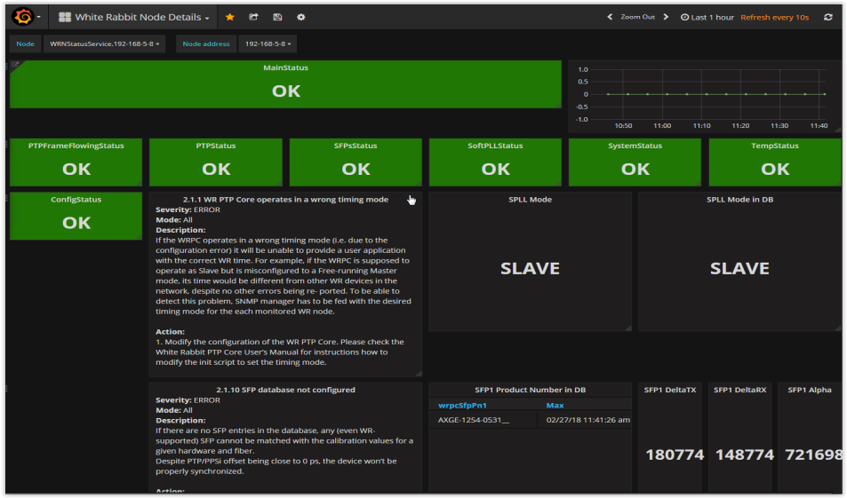
Support and monitoring
FPGA
User logic
B
I
Developed by BE-CO-HT, support eventually by TE-MSC-MM
BTrainFrameTxRx
CO-supported
Controls Open Source
MOnitoring System
WR Streamers
Monitoring
WR Switch and its ports state
WR Node state
Frames tx/rx/lost
Max/min/avg latency
WR PTP Core
Switch monitoring
over SNMP
WR Switch
Nodes monitoring
over SNMP
FPGA
WR PTP Core
WR NEtwork MOnitoring
and Configuration
WR Streamers
Developed by BE-CO-HT, support eventually by TE-MSC-MM
BTrainFrameTxRx
B
I
User logic
19

Slide 76
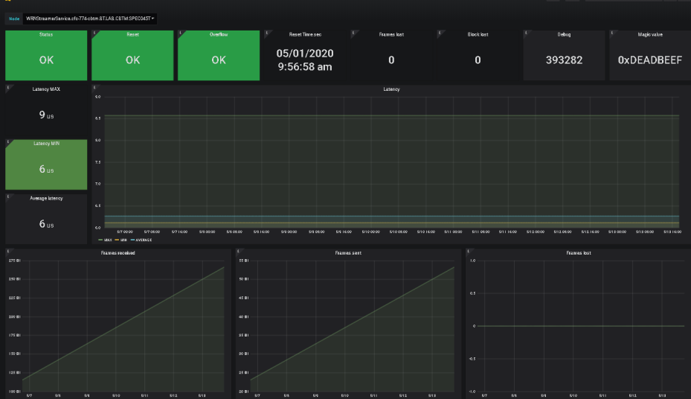
Support and monitoring
FPGA
User logic
B
I
Developed by BE-CO-HT, support eventually by TE-MSC-MM
BTrainFrameTxRx
CO-supported
Controls Open Source
MOnitoring System
WR Streamers
Monitoring
WR Switch and its ports state
WR Node state
Frames tx/rx/lost
Max/min/avg latency
WR PTP Core
Switch monitoring
over SNMP
WR Switch
Nodes monitoring
over SNMP
FPGA
WR PTP Core
WR NEtwork MOnitoring
and Configuration
WR Streamers
Developed by BE-CO-HT, support eventually by TE-MSC-MM
BTrainFrameTxRx
B
I
User logic
19

Slide 77
Status and Plans for BTrain over White Rabbit
Before LS2, successfully used in operation
  PS: since 2015
  ELENA: since its start – no legacy BTrain
  PSB / LEIR: at the end of run 2
with
the above features included
20

Slide 78
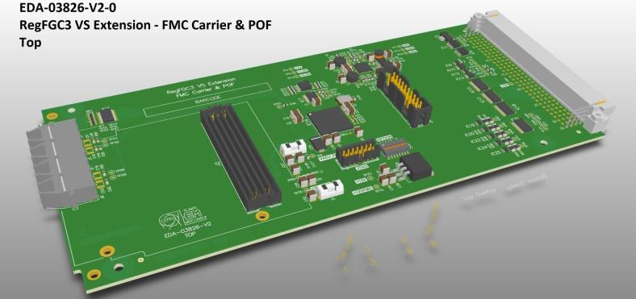
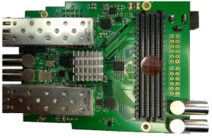
Status and Plans for BTrain over White Rabbit
Before LS2, successfully used in operation
  PS: since 2015
  ELENA: since its start – no legacy BTrain
  PSB / LEIR: at the end of run 2
During LS2
  Release v1.2 of BTrain over WhiteRabbit :
  (https://gitlab.cern.ch/BTrain-Team/BTrain-over-WhiteRabbit/-/wikis/releases)
    WR streamers fixed-latency improved from ± 8ns to sub-ns
    Support for Cute-WR-DP FMC
    Support for BTrain API on FMC pins
  Deployment of WR Nodes monitoring
  Update of WR Switch firmware/config
FMC carrier
FMC card
20

Slide 79
Status and Plans for BTrain over White Rabbit
Before LS2, successfully used in operation
  PS: since 2015
  ELENA: since its start – no legacy BTrain
  PSB / LEIR: at the end of run 2
During LS2
  Release v1.2 of BTrain over WhiteRabbit :
  (https://gitlab.cern.ch/BTrain-Team/BTrain-over-WhiteRabbit/-/wikis/releases)
    WR streamers fixed-latency improved from ± 8ns to sub-ns
    Support for Cute-WR-DP FMC
    Support for BTrain API on FMC pins
  Deployment of WR Nodes monitoring
  Update of WR Switch firmware/config
After LS2, operational in PSB, LEIR, PS, SPS, AD, ELENA
FMC carrier
FMC card
20

Slide 80
Conclusions
BTrain – critical system in PSB, LEIR, PS, SPS, AD, ELENA
White Rabbit – suitable CO-supported technology, versatile and flexible
BTrain over White Rabbit
  at the heart of the FIRESTORM project
  common interface between all BTrain users
  a smooth inter-department and inter-group collaboration
  between TE-MSC, TE-EPC, BE-RF, BE-BI facilitated BE-CO.
See: https://wikis.cern.ch/display/HT/Btrain+over+White+Rabbit
21

Slide 81

Conclusions
BTrain – critical system in PSB, LEIR, PS, SPS, AD, ELENA
White Rabbit – suitable CO-supported technology, versatile and flexible
BTrain over White Rabbit
  at the heart of the FIRESTORM project
  common interface between all BTrain users
  a smooth inter-department and inter-group collaboration
  between TE-MSC, TE-EPC, BE-RF, BE-BI facilitated BE-CO.
Thank you !
See: https://wikis.cern.ch/display/HT/Btrain+over+White+Rabbit
21

Slide 82
Outline
Introduction to WR and overview of its applications
BTrain over WR (Maciej)
WR Trigger Distribution (Dimitris)
RF Signal Distribution over WR (John)
Q&A

